Slide 1
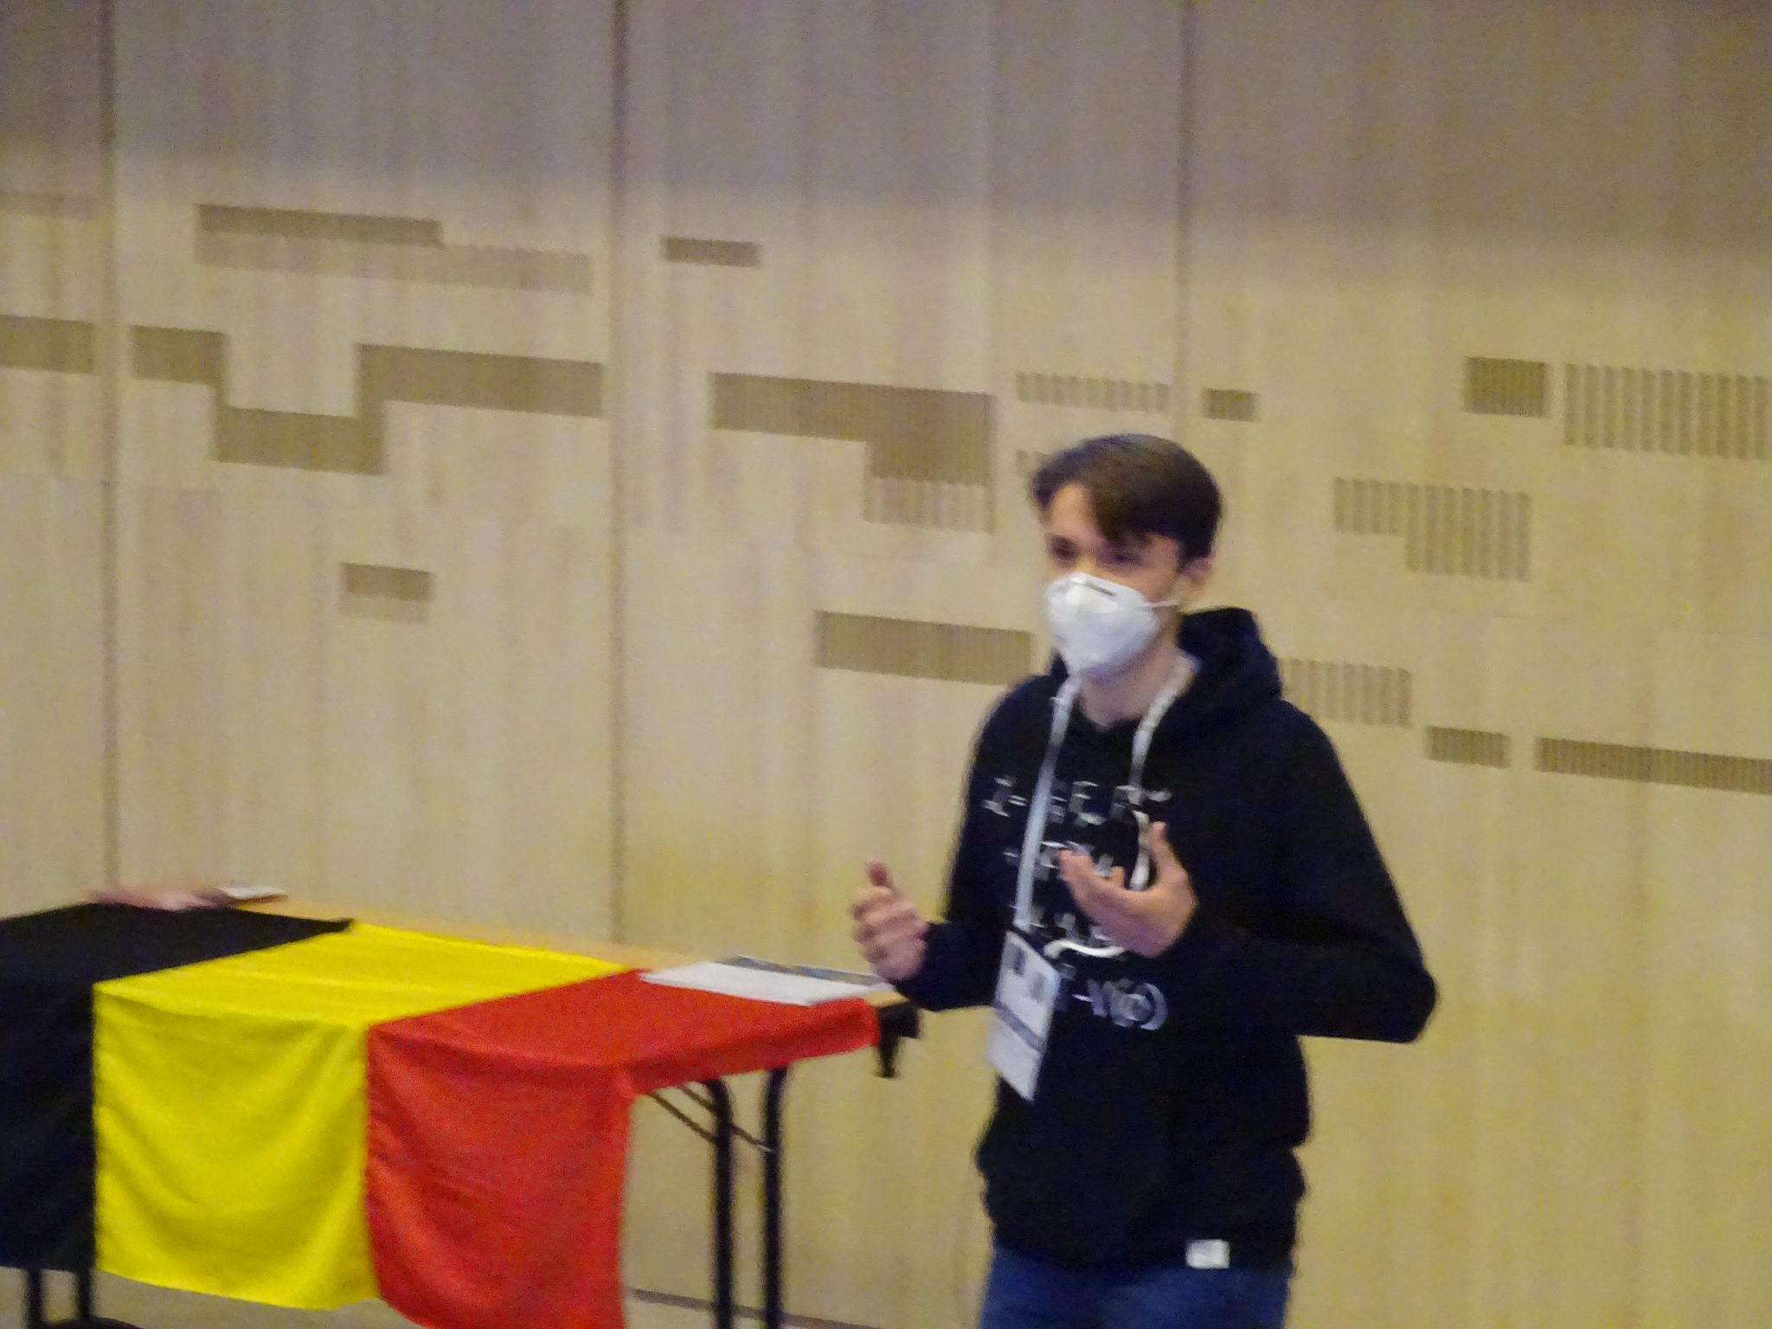
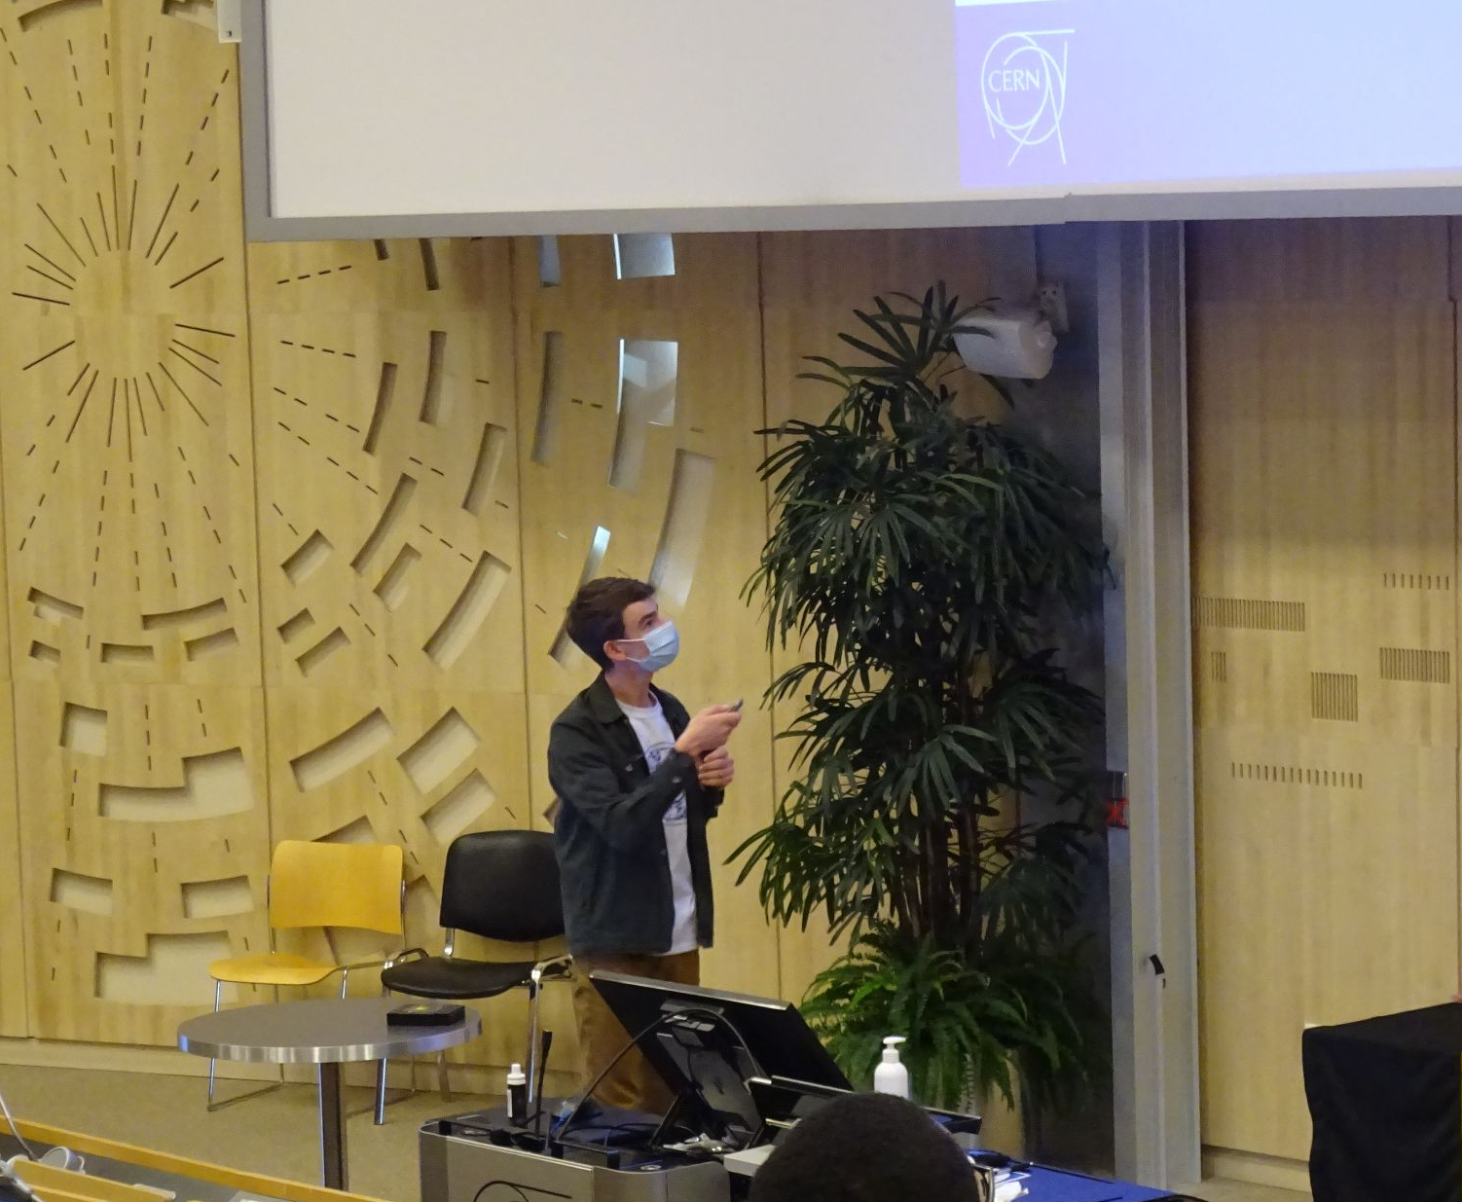
Cloud Infrastructure
By Xander & Laurens
Again…
Notes:
Short introduction

Slide 2
The Cloud: What?
Sharing resources
Data Storage
Data management
Easy access

Slide 3
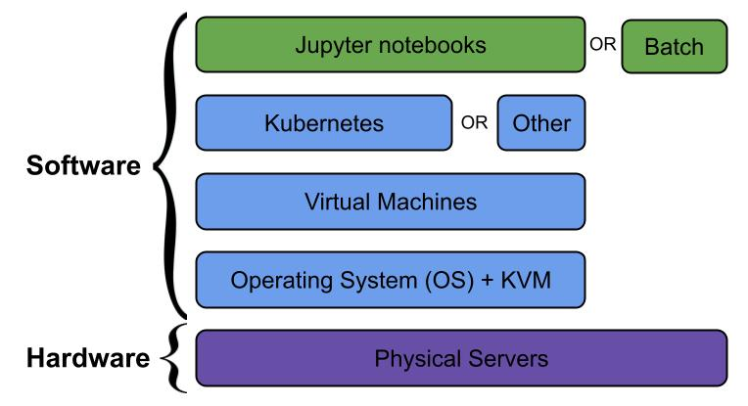
The Cloud: How?
Composed of layers
Top layer = for analysis
Other layers = for structure

Slide 4
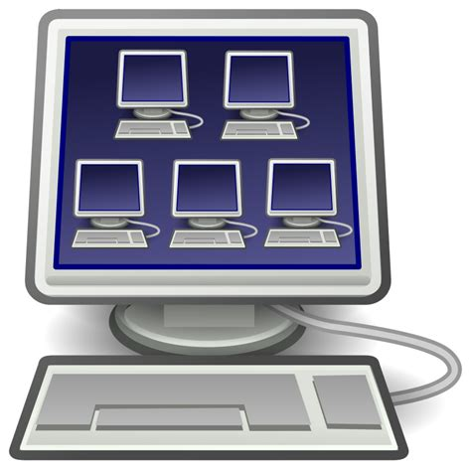
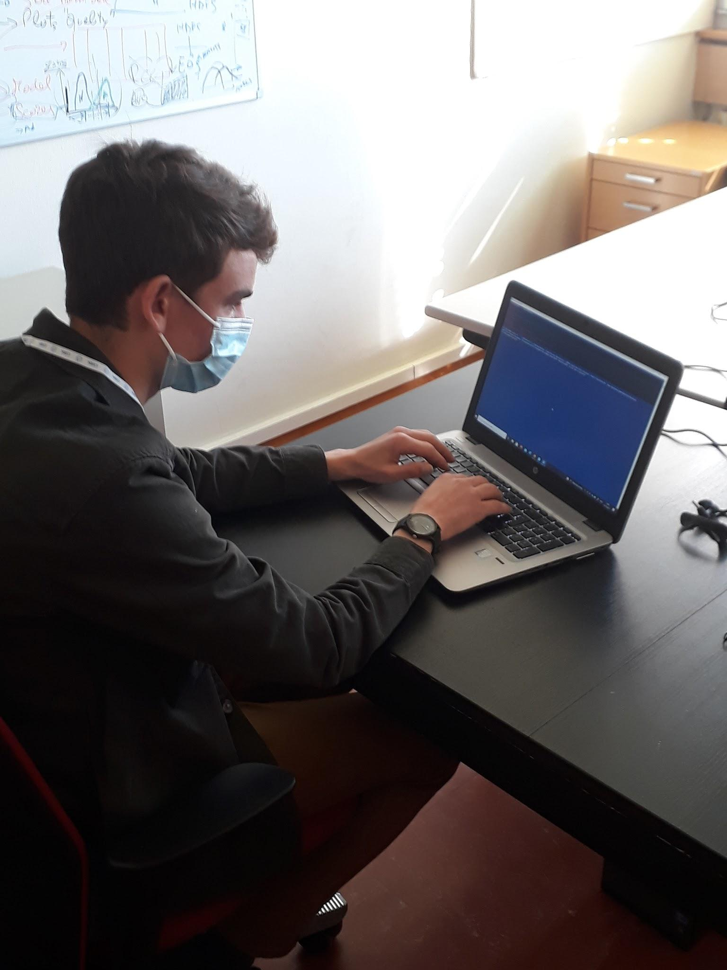
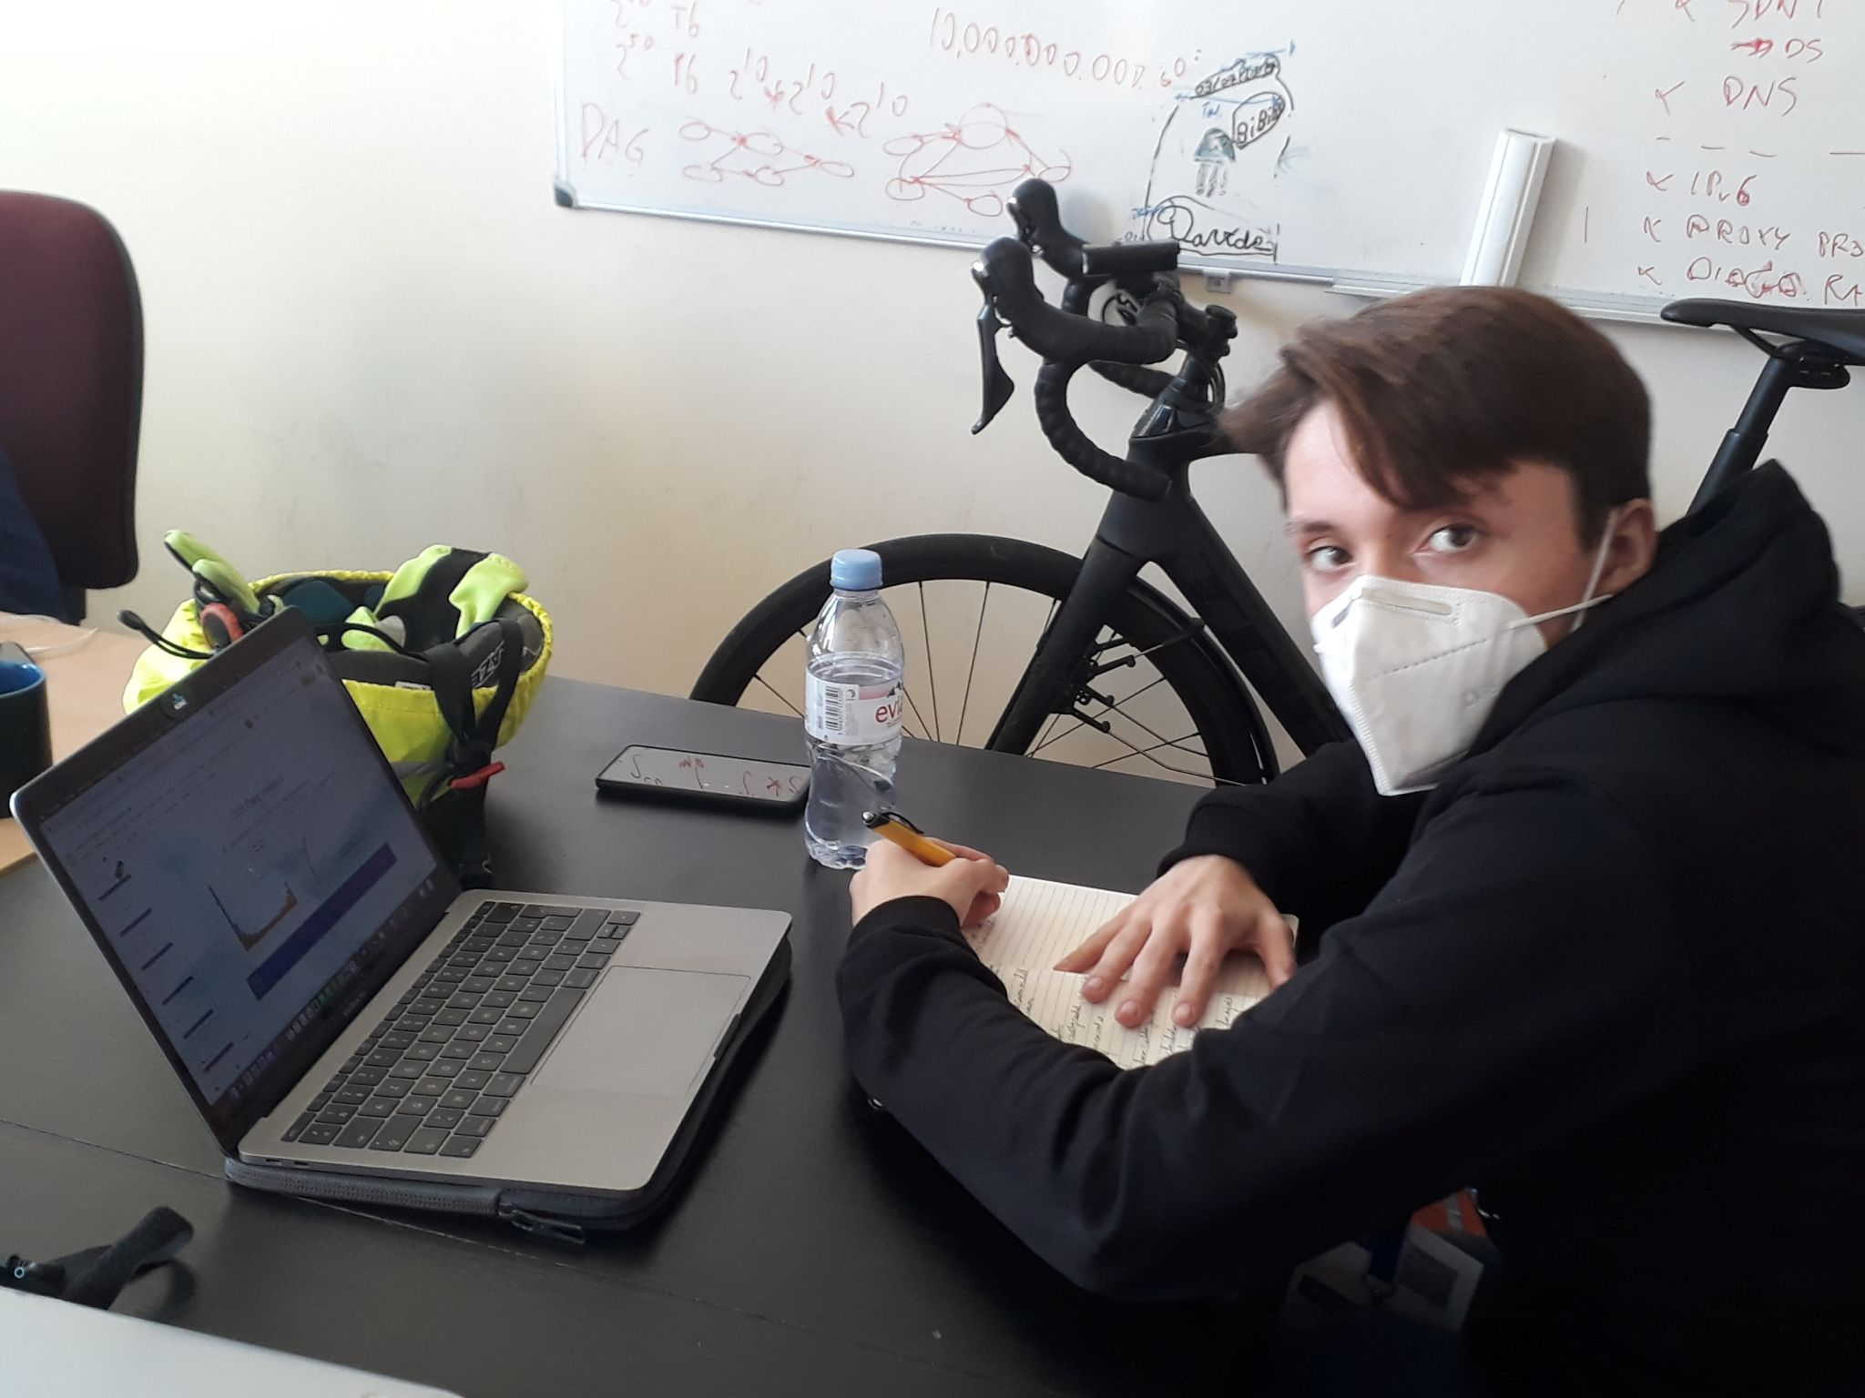
For example:
Virtual Machines
GPU’s
Notes:
On these slides are a few small projects we did.
We created virtual machines (VM’s), where you essentially virtually divide a server into smaller parts, to make better use of your resources. We also created volumes (storage room) and connected them to the VM’s.
Something else we did, was using GPU’s (Graphical Processing Units). These can be used for very complex calculations because they perform multiple calculations simultaneously.

Slide 5
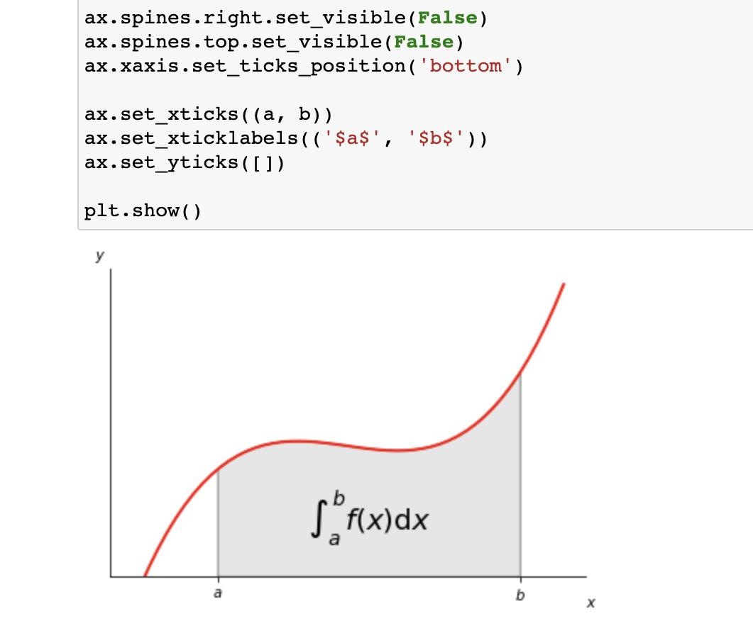
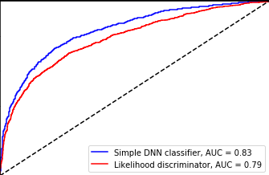
For example:
CMS Data Analysis
SWAN
Classification of peaks
Identification of QCD-jets with Machine Learning
Notes:
SWAN stands for Service for Web-based Analysis. It is an online tool that you can use for example to calculate integrals.
You don’t need to have the hardware yourself, all you need is an internet connection.
We also did a small project on CMS Data Analysis, consisting of 2 parts: first we wrote a program to identify different particles from the graph above, and then we used a simple artificial intelligence to classify QCD-jets (in the graph above you can see that this AI (blue line) performed significantly better then the manually written program (red line)).

Slide 6
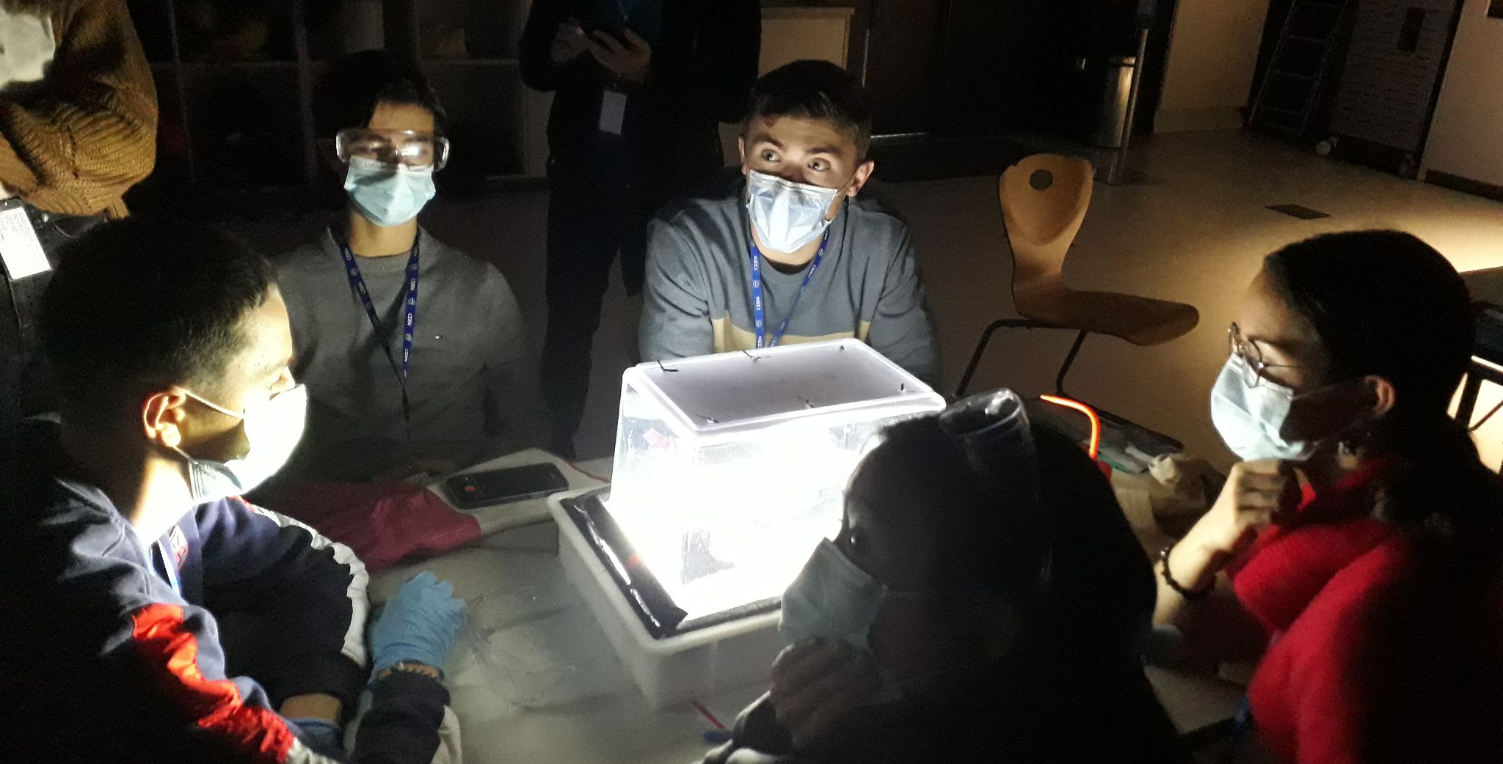
Our actions afterwards
Notes:
After the internship, we tried to share our experience both via social media and by talking about it with friends and family.
To spread it to others as well, we have both done an interview and a presentation in front of the class.
Laurens is currently trying to implement an experiment we did at CERN at my school: making a cloud chamber to see particle tracks with our own eyes (see picture).

Slide 7
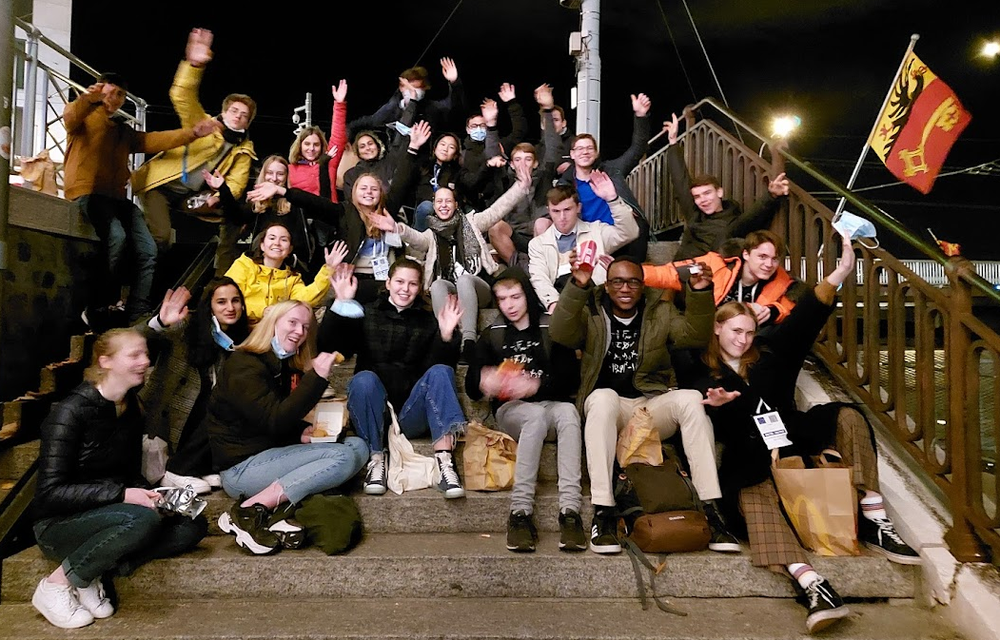
Why CERN was (and is) awesome:
Learning about…
Particle physics & IT
English (and some French as well)
Cooperating
How scientific institutions like CERN function
Throwing paper airplanes ; )
International environment
A wider perspective
Being more self-reliant
An awesome group of friends

Slide 8
Many thanks to:
Our supervisor (and the entire IT department)
Everyone who made this internship possible
All of you for listening : )
Thank you!

