Slide 1
BE HSSIP
From Alexia’s and Anna’s point of view

Slide 2
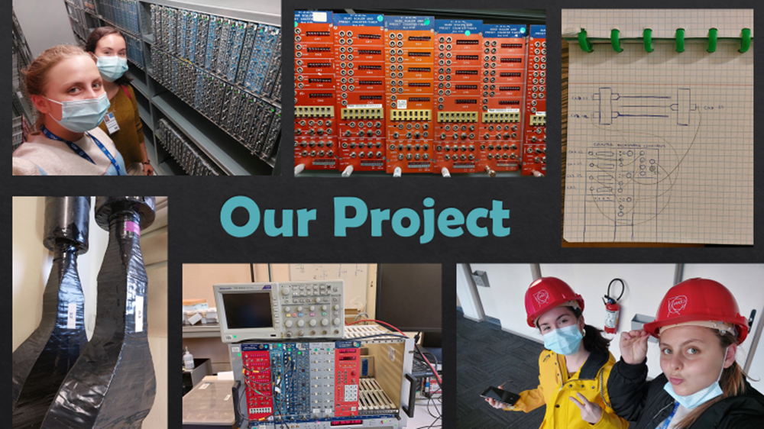

Slide 10
