Slide 1
Internet of Things (IoT) Belgian HSSIP
Emma Zhu, Petar Vitorac, Robin Vierlinck
March 2022

Slide 2
Our project at CERN
March 2022
Emma Z., Petar V., Robin V. | Internet of Things

Slide 3
Introduction: devices at CERN
Robots at data center
TIM
(robot in the LHC)
Proximeters
March 2022
Emma Z., Petar V., Robin V. | Internet of Things

Slide 4
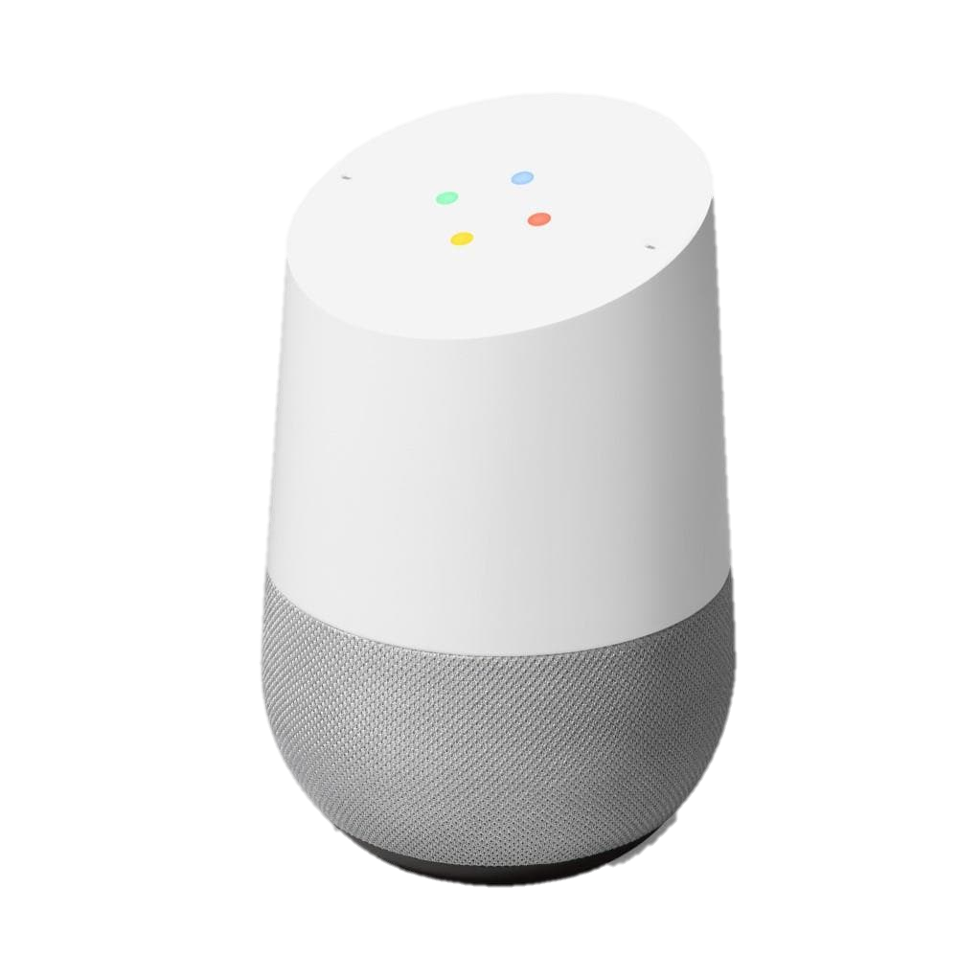
Internet of Things: examples
ANYTHING
March 2022
Emma Z., Petar V., Robin V. | Internet of Things
Notes:
Now, could you give us a few examples of IoT devices in the every day life?
There are many examples such as: Google Home, smart fridges, smart lights, basically, almost anything!

Slide 5
Internet of Things: functioning
Using protocols
= way of communication
Analogy for humans: phone, SMS, e-mail, …
Examples:
TCP (= Transmission Control Protocol)
HTTP (= Hypertext Transfer Protocol)
MQTT (= Message Queuing Telemetry Transport)
March 2022
Emma Z., Petar V., Robin V. | Internet of Things

Slide 6
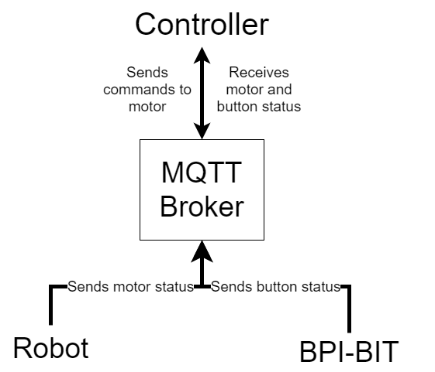
Our IoT project: organization
March 2022
Emma Z., Petar V., Robin V. | Internet of Things

Slide 7
March 2022
Emma Z., Petar V., Robin V. | Internet of Things

Slide 8
Our actions after the internship
March 2022
Emma Z., Petar V., Robin V. | Internet of Things

Slide 9
Our actions after the internship
EMMA
March 2022
Emma Z., Petar V., Robin V. | Internet of Things

Slide 10
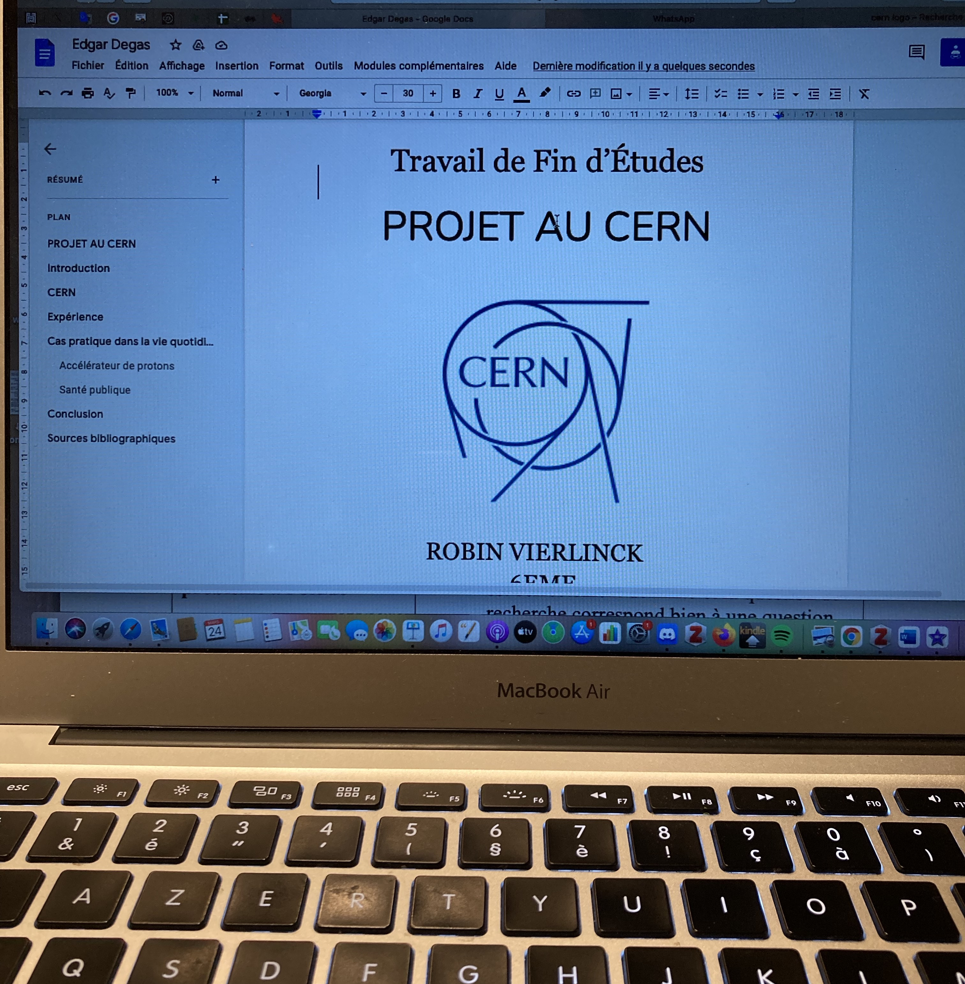
Our actions after the internship
EMMA
ROBIN
March 2022
Emma Z., Petar V., Robin V. | Internet of Things

Slide 11
Our actions after the internship
EMMA
ROBIN
PETAR
March 2022
Emma Z., Petar V., Robin V. | Internet of Things

Slide 12
Our experience in general
March 2022
Emma Z., Petar V., Robin V. | Internet of Things

Slide 13
Many thanks to our supervisors,
Brice Copy and Thomas Oulevey

