Slide 1
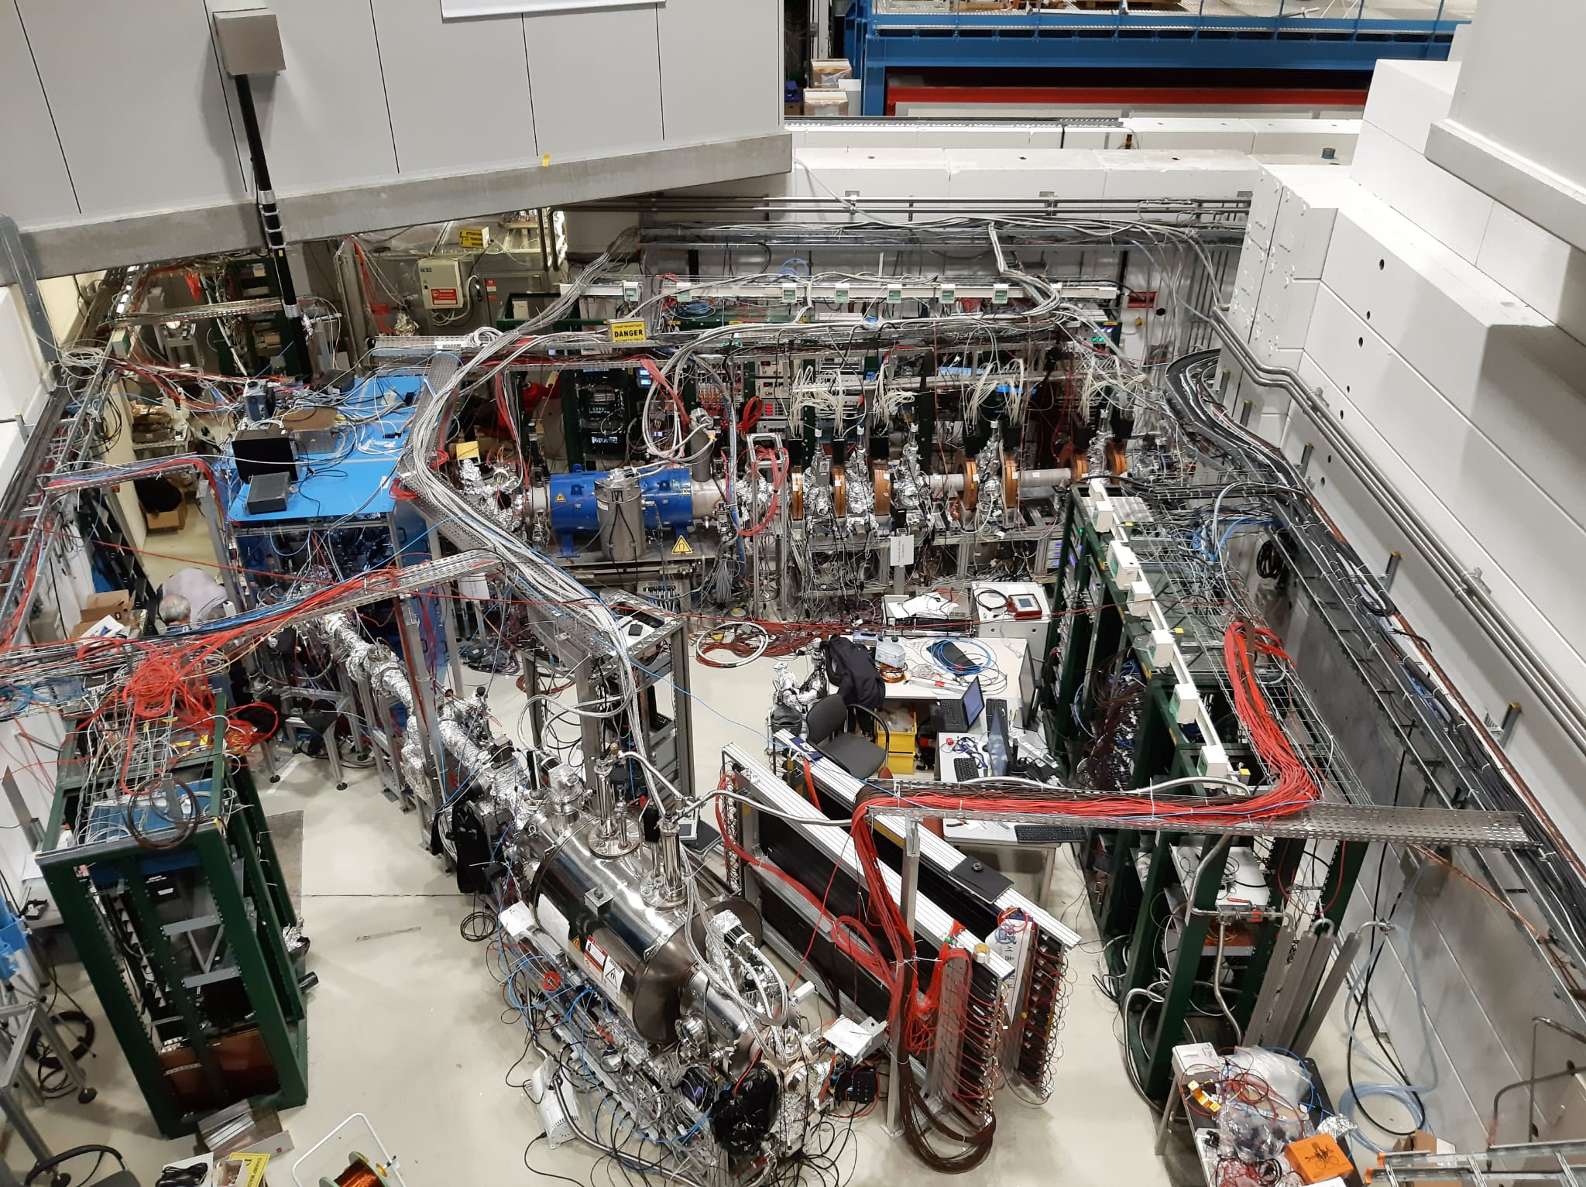
ISOLDE
Elke, Wout, Tim and Holy

Slide 2
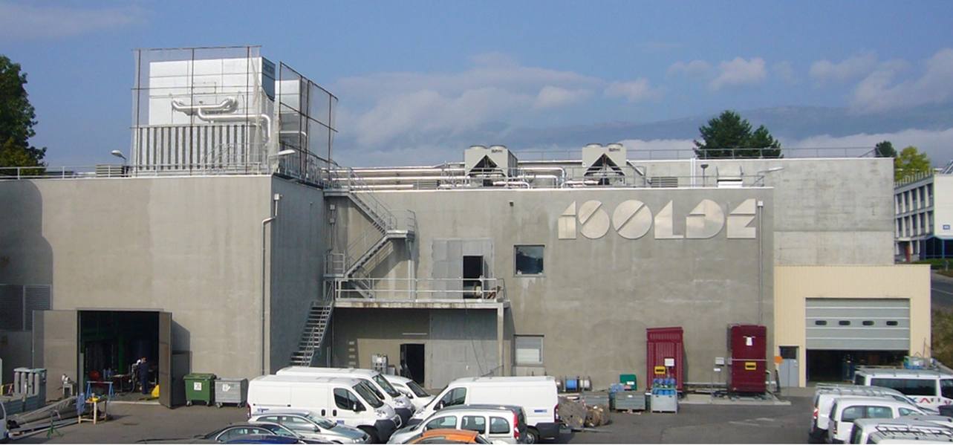
ISOLDE
ISOLDE is a facility dedicated to the production of a large variety of radioactive ion beams (RIBs)
Holy and Elke
Elke, Wout, Tim and Holy

Slide 3
The working process
Holy and Elke
Elke, Wout, Tim and Holy

Slide 4
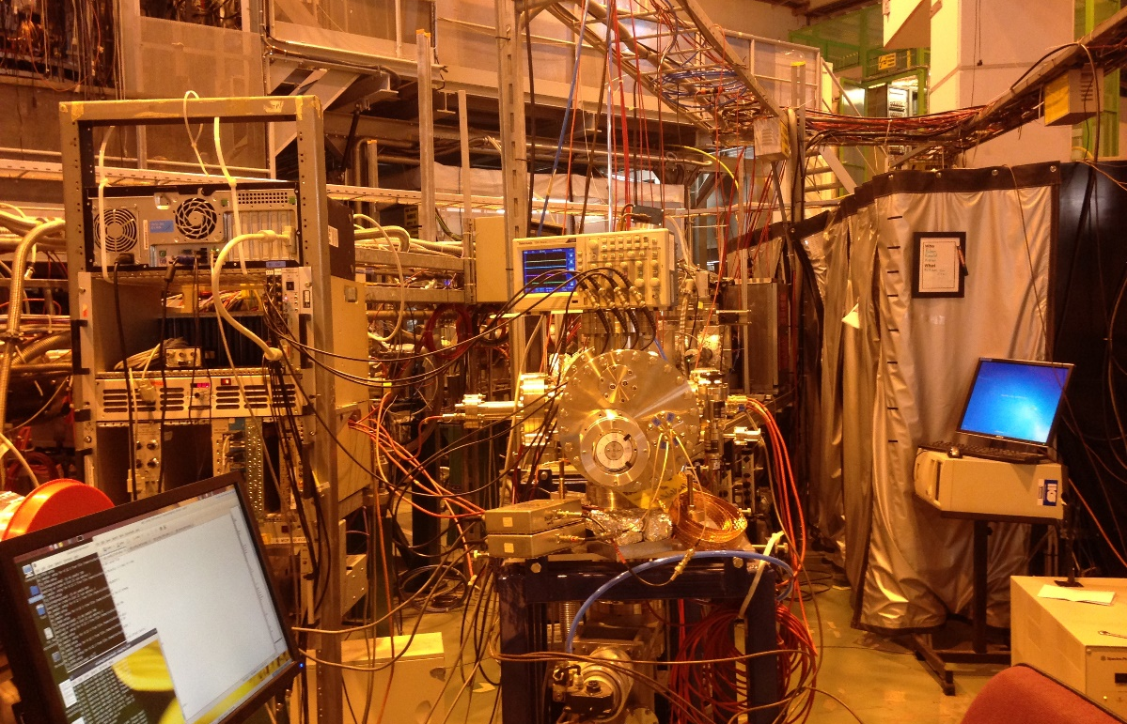
CRIS
CRIS: Laser spectroscopy to measure the properties of the nucleus
Holy and Elke
Elke, Wout, Tim and Holy

Slide 5
Studying the energy levels of the atom
We study these electronic energy levels, using lasers
Energy levels
Incident
photon
Holy and Elke
Elke, Wout, Tim and Holy

Slide 6
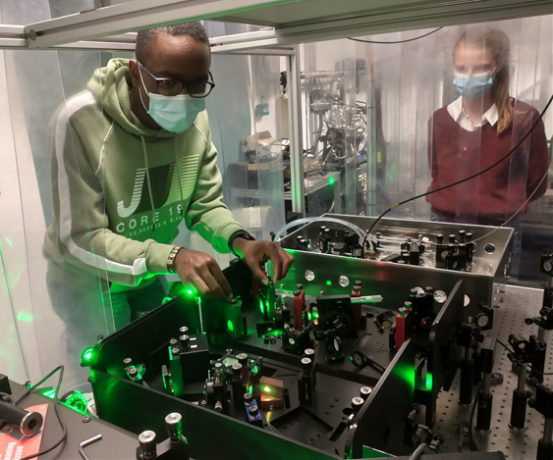
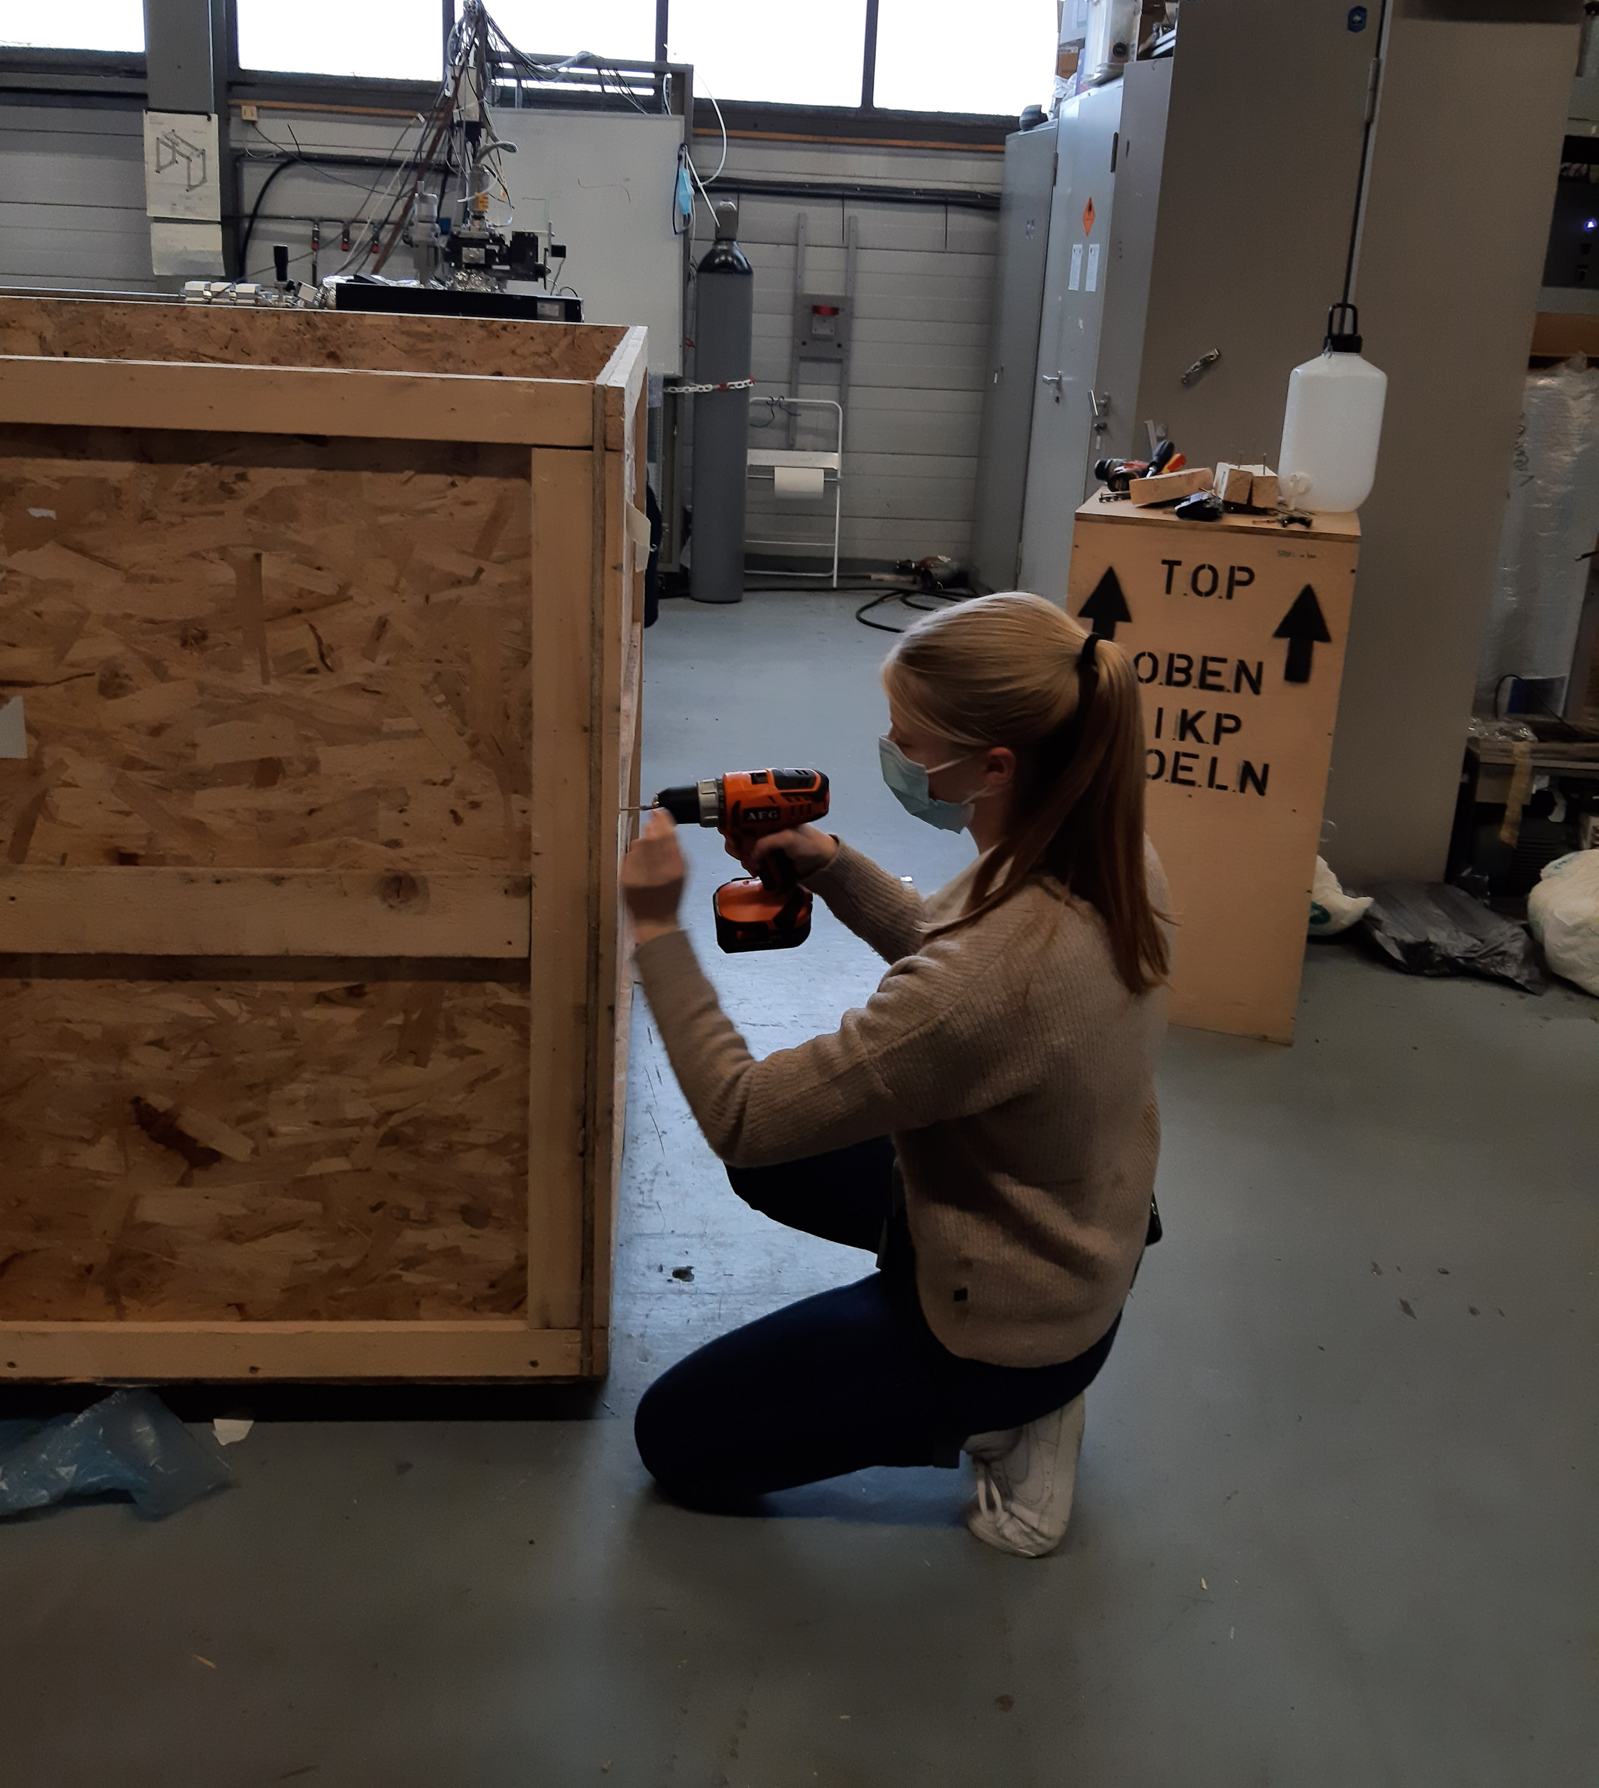
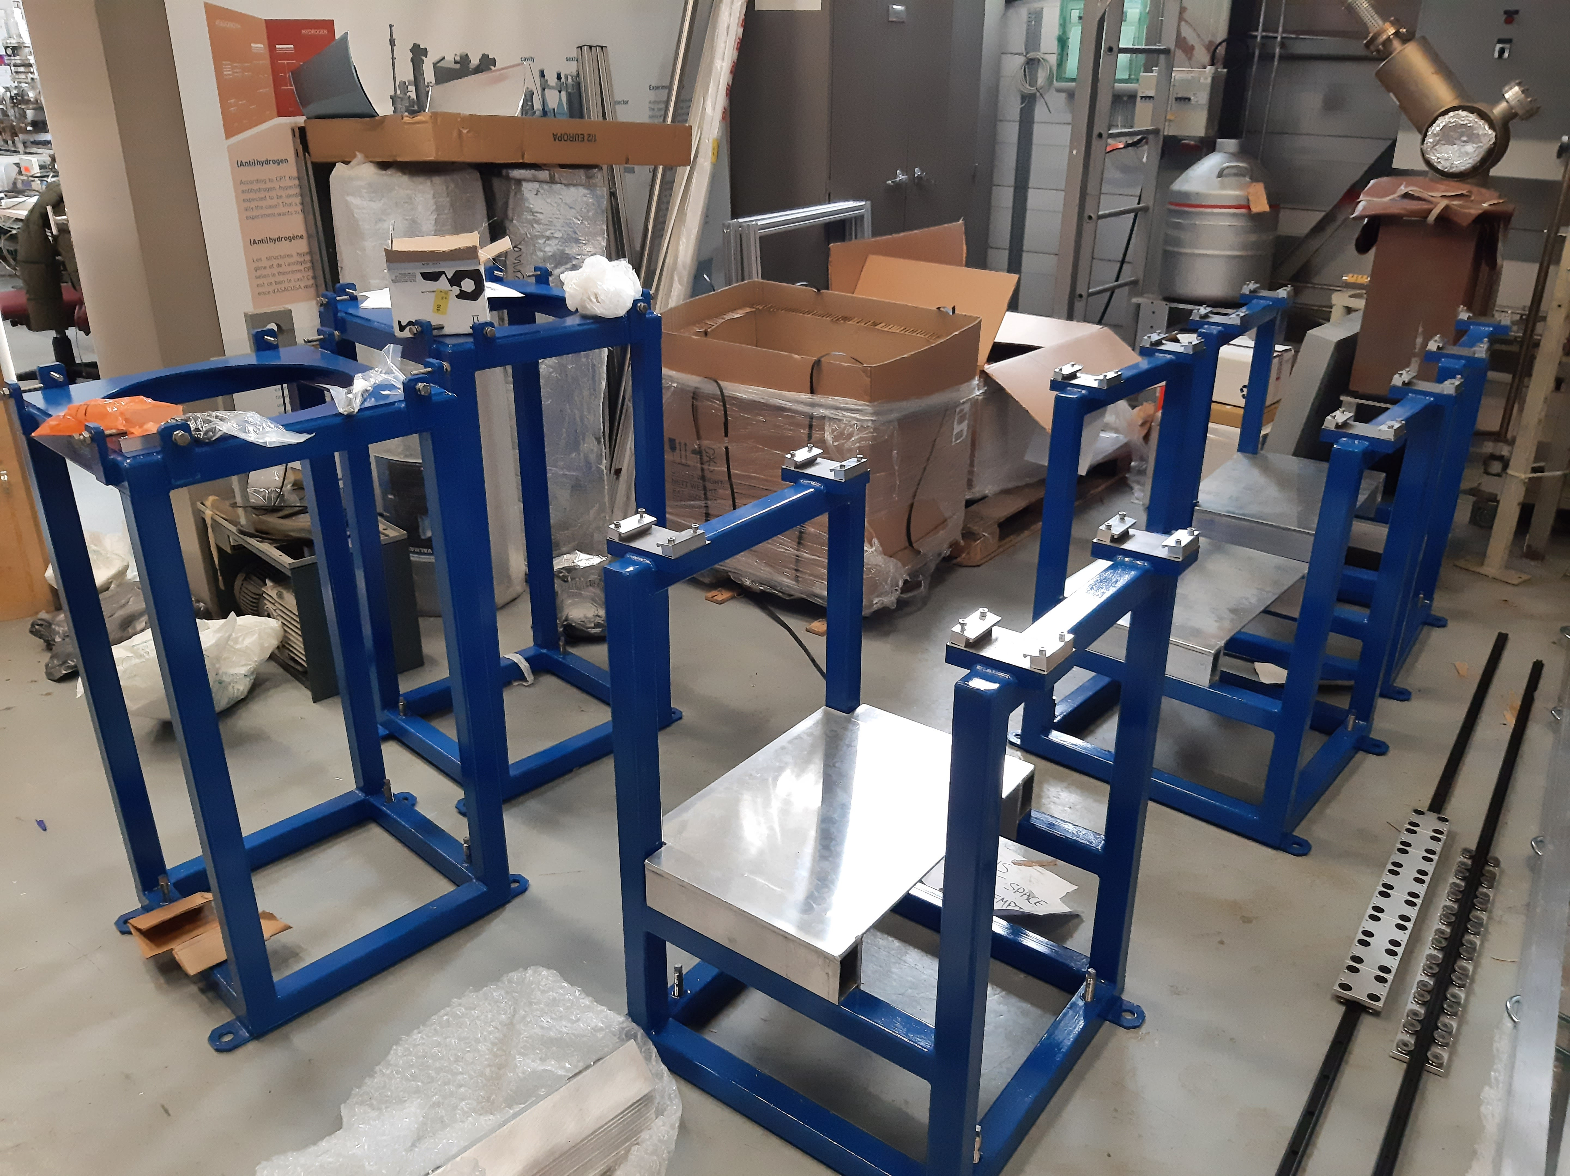
What did we do?
Elke, Wout, Tim and Holy

Slide 7
Alpha and beta decay studies at WISArD
By T.Camps and W.Helsen
Elke, Wout, Tim and Holy

Slide 8
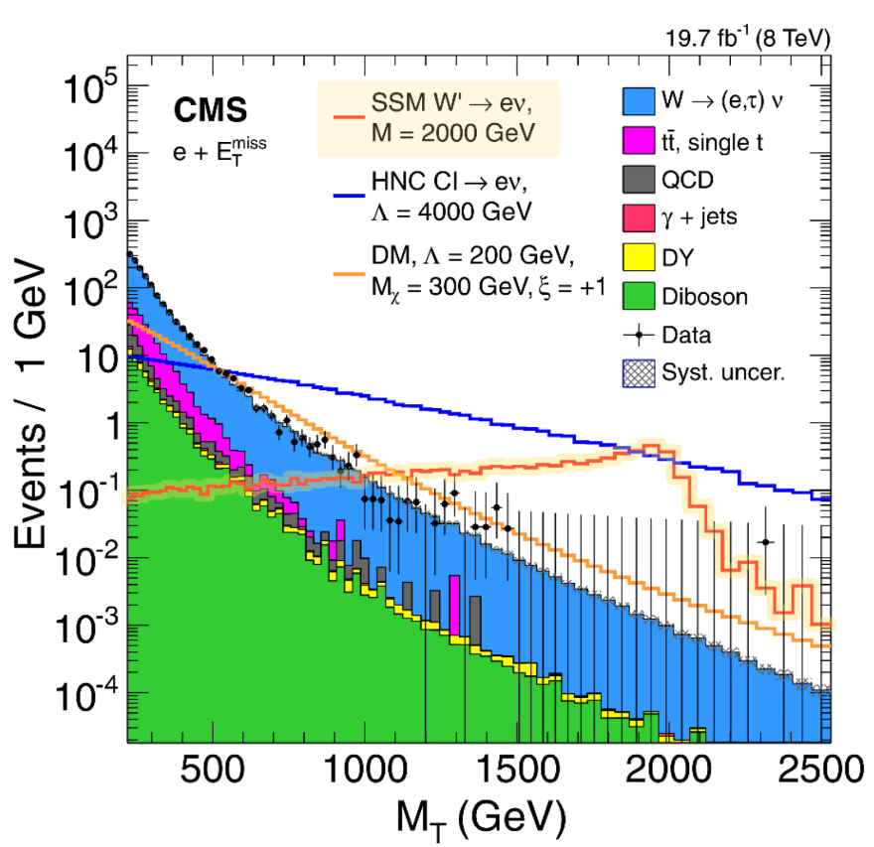
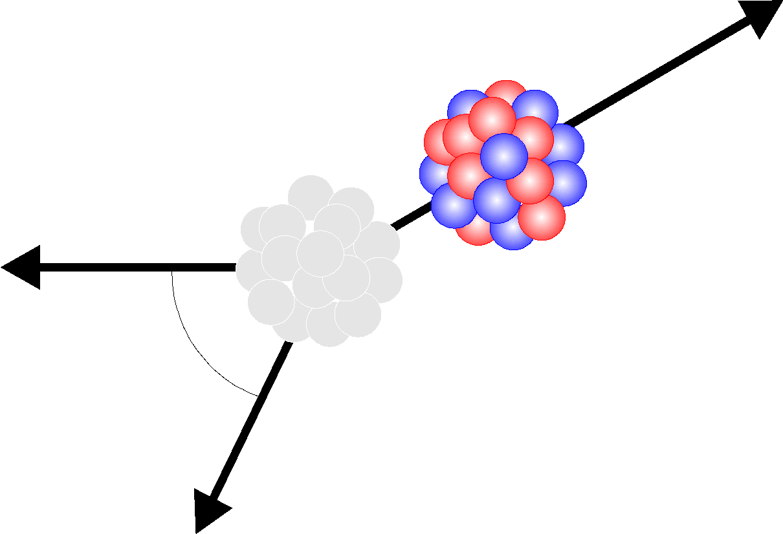
Purpose experiment
I) Energy frontier, i.e LHC experiments
II) Precision frontier,
WISArD
e⁺
nucleus
θ
ν_{e}
Elke, Wout, Tim and Holy

Slide 9
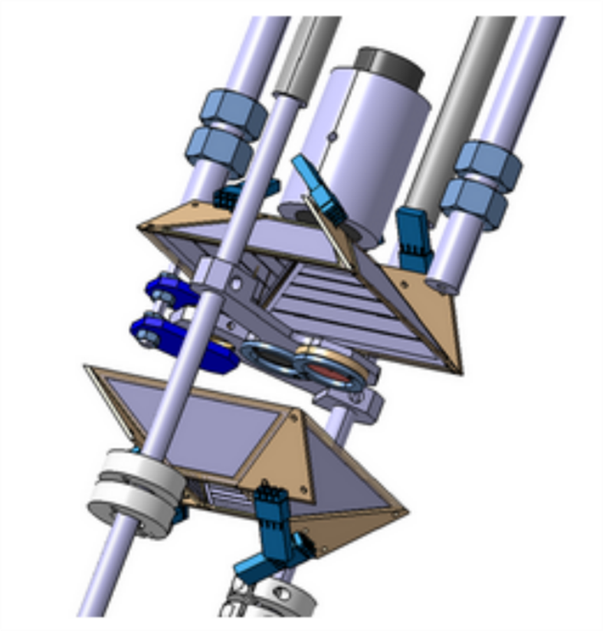
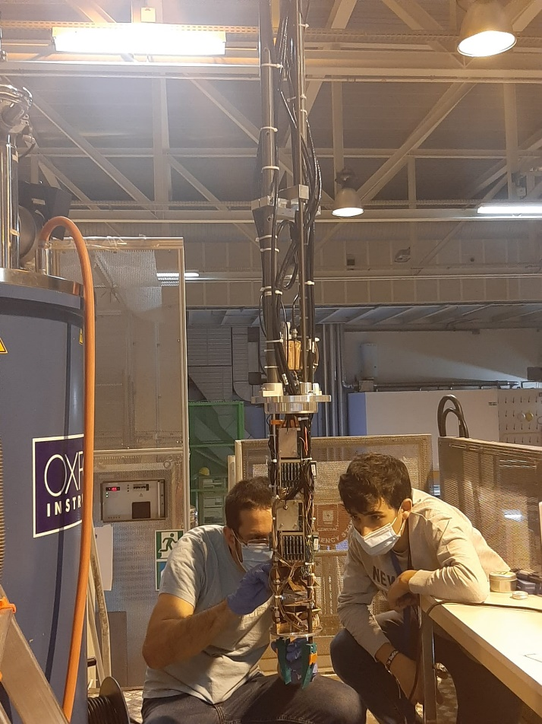
Setup experiment
Elke, Wout, Tim and Holy

Slide 10
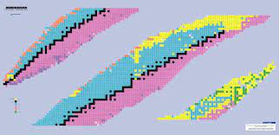
Radioactive decay
Types of decay: α,β, ɣ,…
Elke, Wout, Tim and Holy

Slide 11
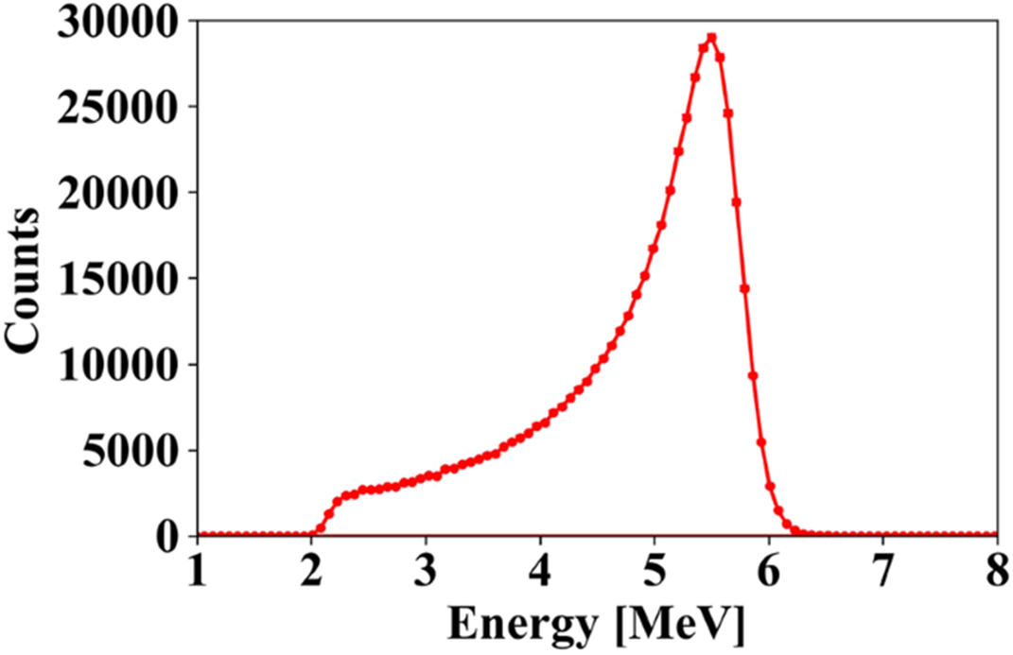
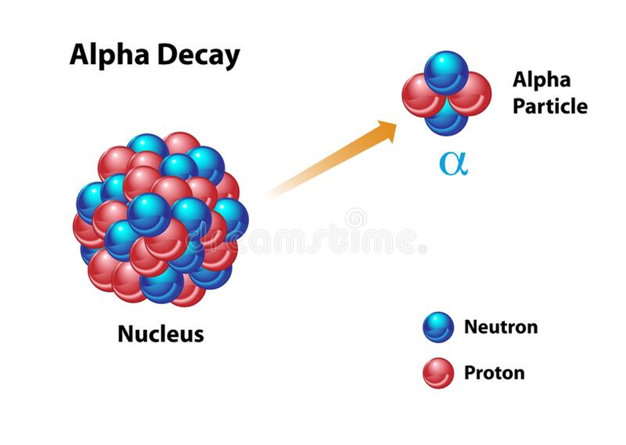
α decay of Po 208
Unstable → Stable
Po 208
α
Half life: 2,9 years
Pb 204
Elke, Wout, Tim and Holy

Slide 12
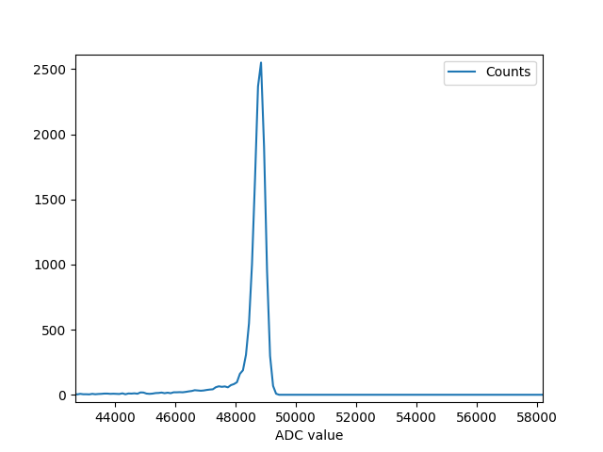
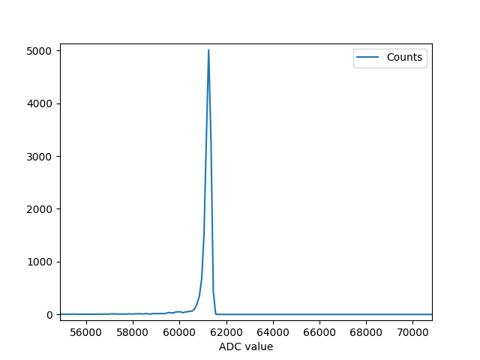
Without calibration
Detector 1
Detector 2
Elke, Wout, Tim and Holy

Slide 13
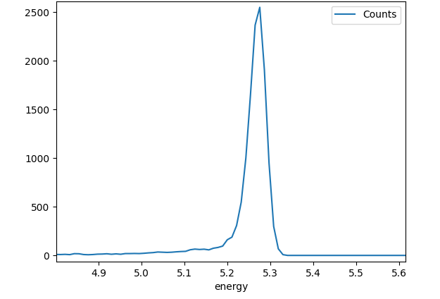
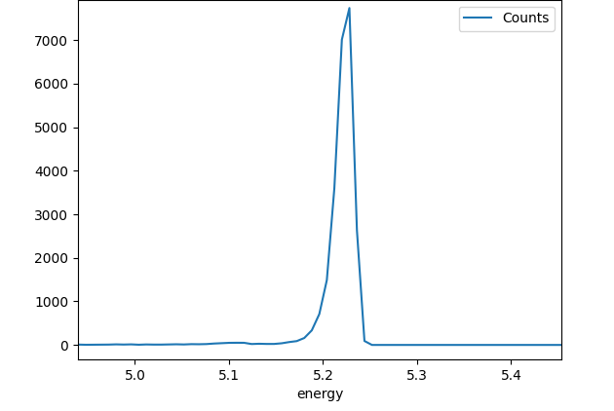
With calibration
Detector 1
Detector 2
Elke, Wout, Tim and Holy

Slide 14
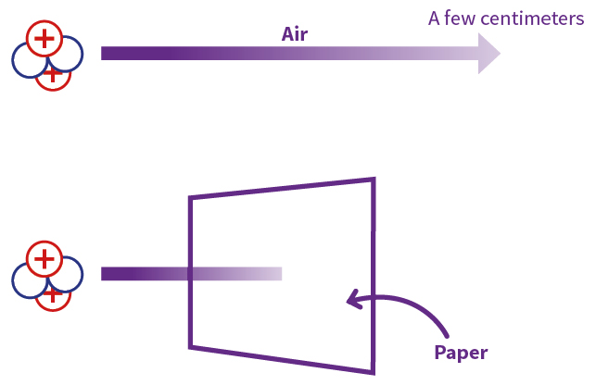
Dangers of α particles
Elke, Wout, Tim and Holy

Slide 15
β- decay
Neutrino and electron share the energy of the recoil caused from the decay
Elke, Wout, Tim and Holy

Slide 16
Theoretical model for β- decay
Elke, Wout, Tim and Holy

Slide 17
Source
Sr90 Y90 Zr90
Elke, Wout, Tim and Holy

Slide 18
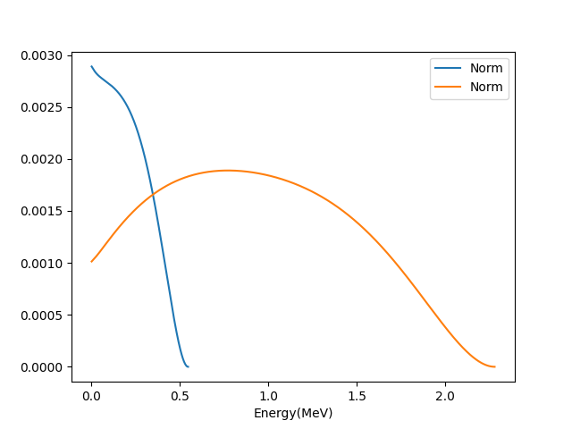
Project
Expirimental β- spectrum of Sr90
Theoretical β- spectrum of Sr90 and Y90
Elke, Wout, Tim and Holy

Slide 19
What did we do to share the amazing experience?
Elke, Wout, Tim and Holy

Slide 20
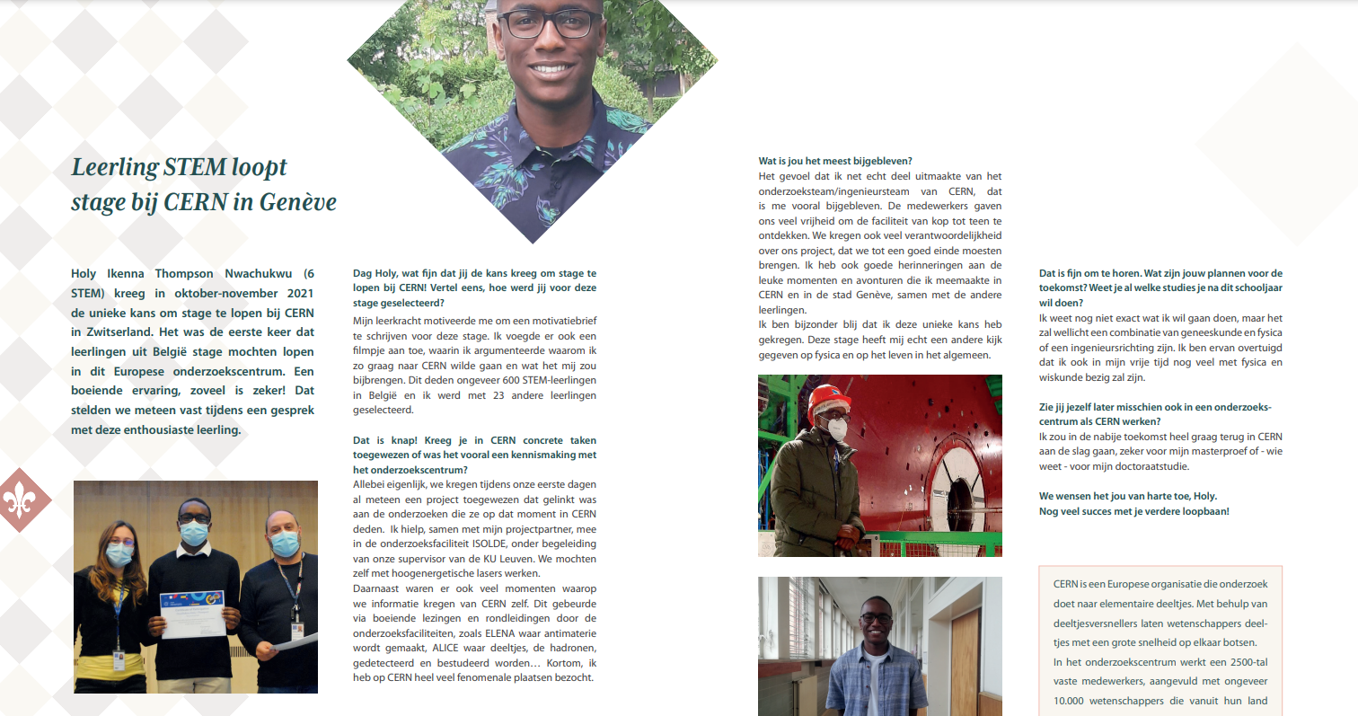

Slide 21
OUR PERSONAL VIEWS
Elke, Wout, Tim and Holy

Slide 22
Elke, Wout, Tim and Holy

