Slide 1
Safety at CERN
By Charles Demy and Elena Schmit
Supervised by Pierre Carbonez and Andre Dziewa

Slide 2
HSE
Occupational Health & Safety and Environmental Protection Unit
Radiation protection group, environmental protection group, CERN fire brigade, occupational and safety group and transversal services group

Slide 3
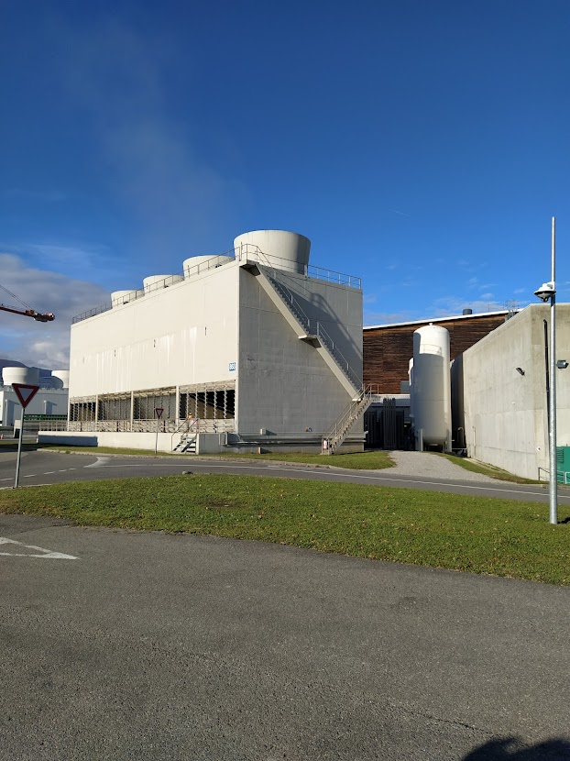
Water protection
- Cooling down instruments
- Heat exchanger between distilled water and water
- Cooling towers
- Chemicals => chlorine

Slide 4
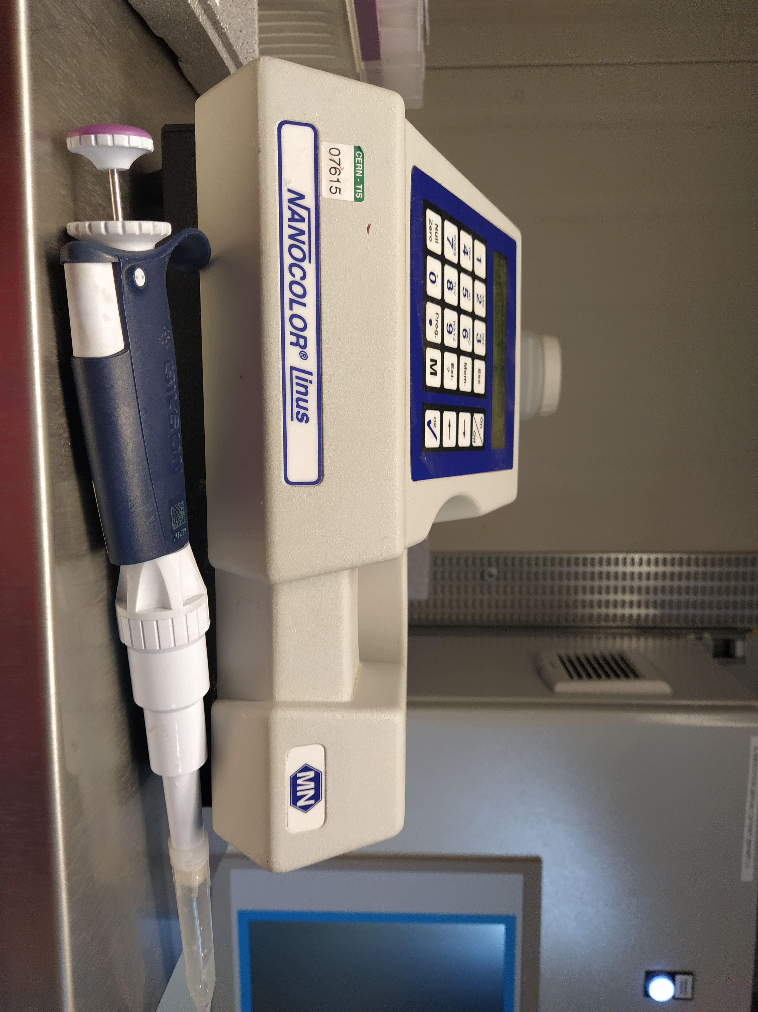
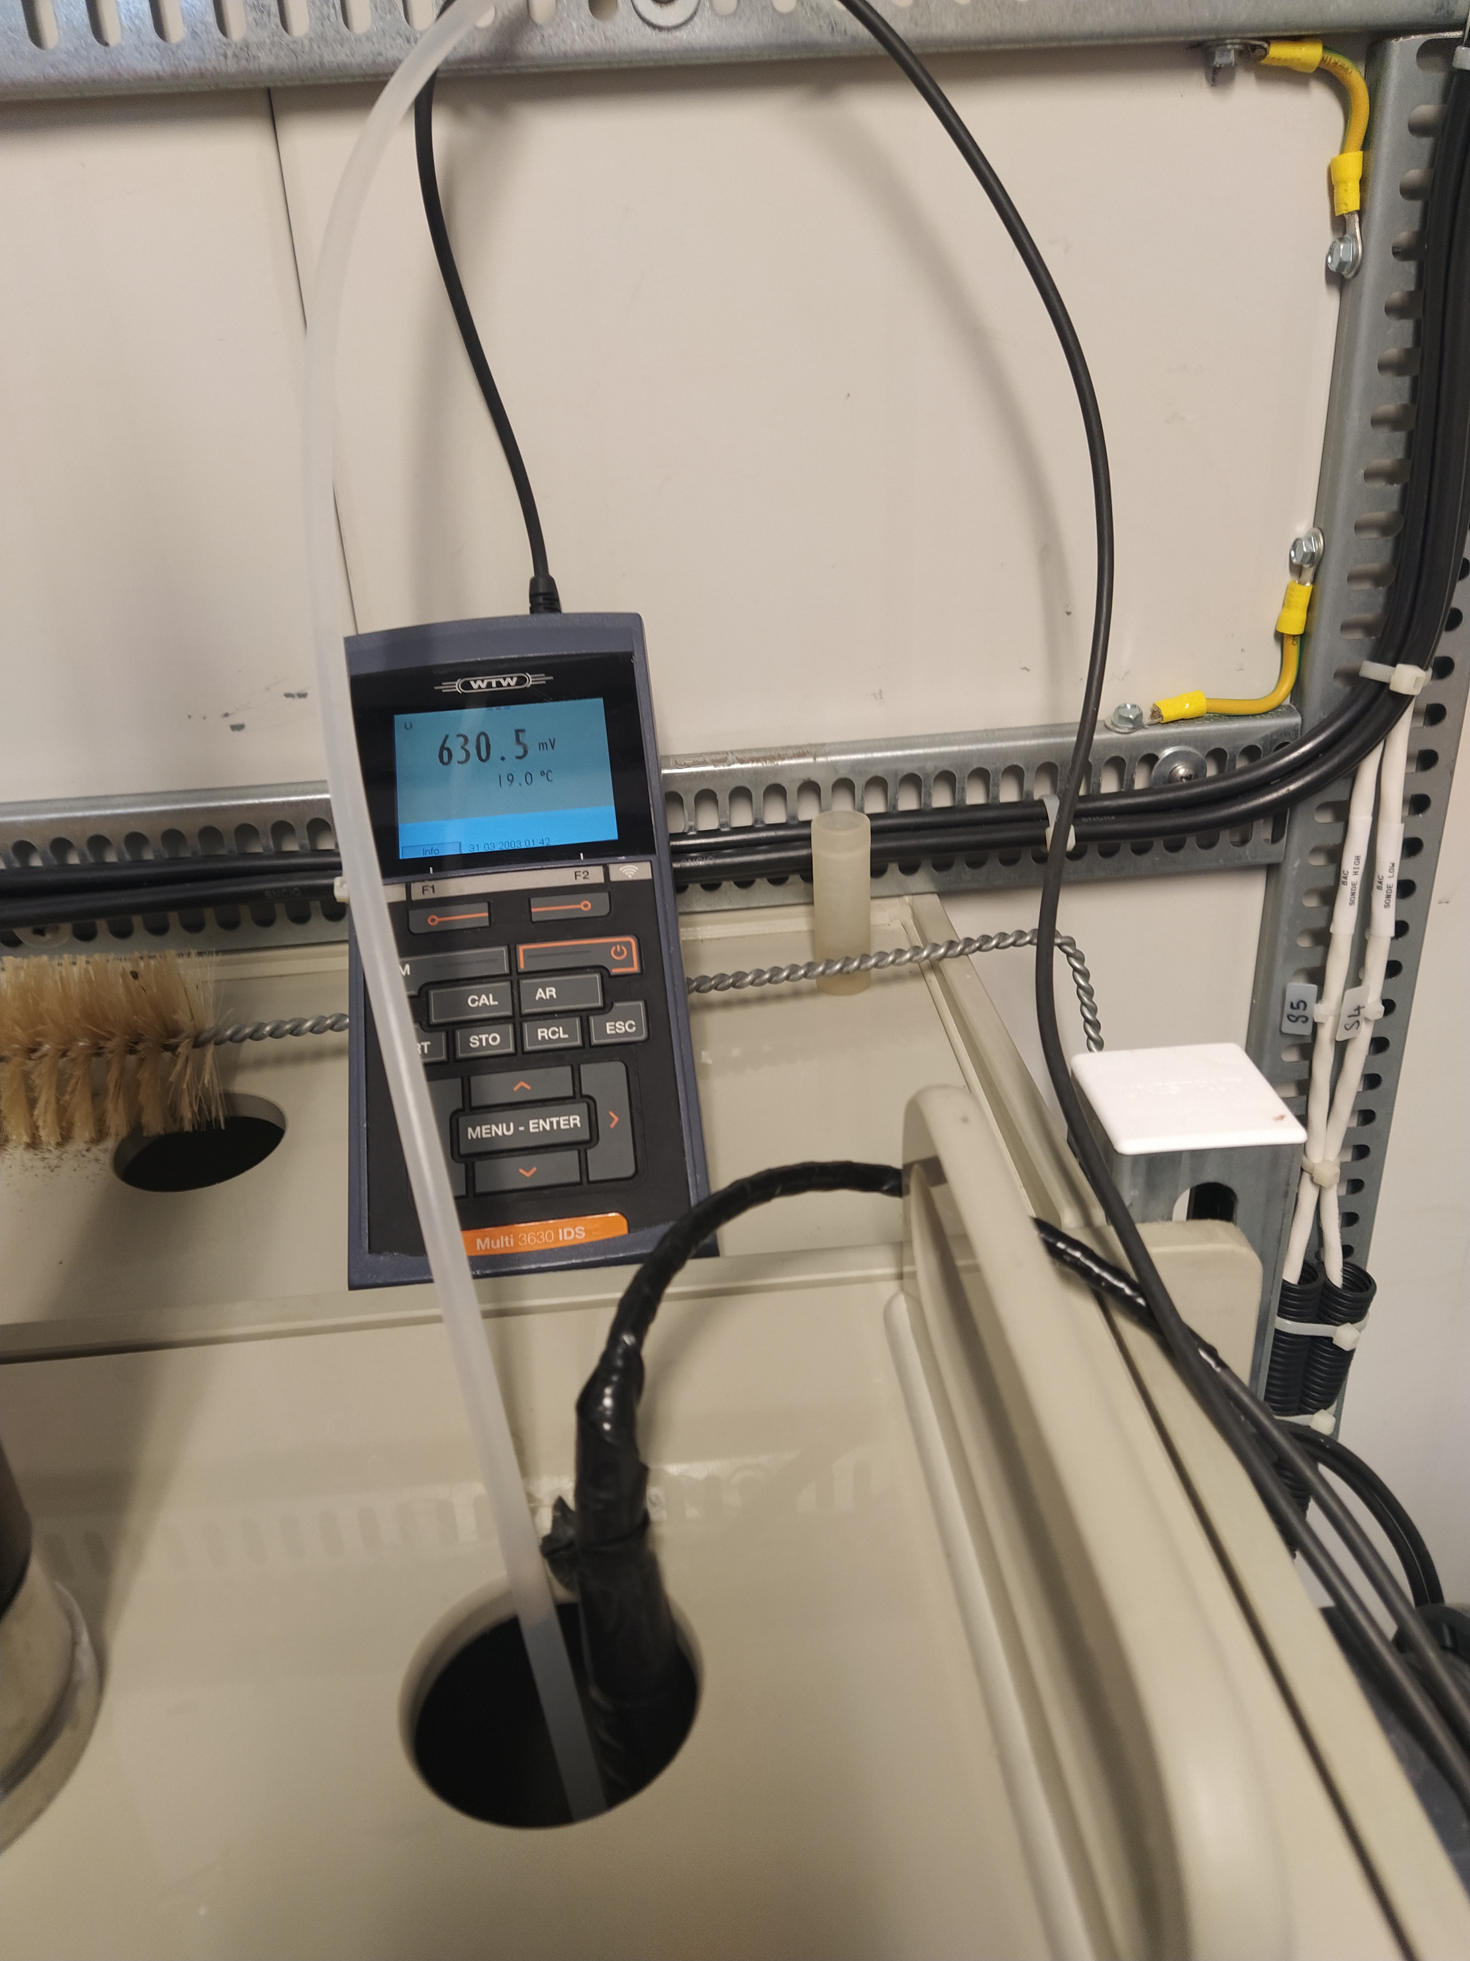
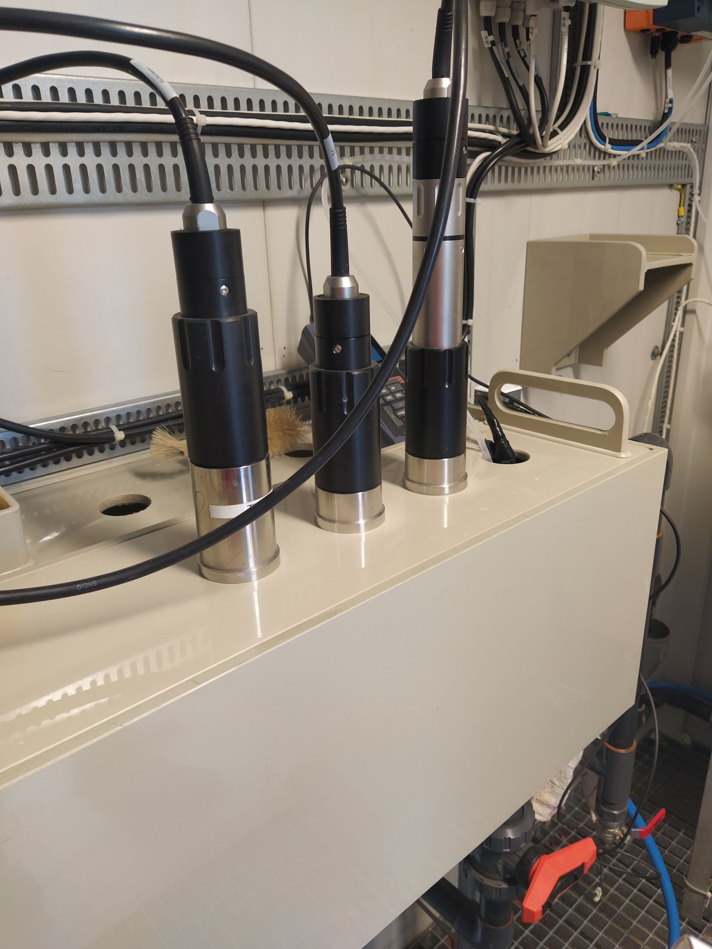
What was the project?

Slide 5
Research results
Correlation coefficient: -0,06953146 (neglectable)

Slide 6
Conclusion 1
To succeed a research, you need:
-a lot of data
-a lot of patience
-a lot of motivation
-a lot of knowledge
…
-and a bit of luck

Slide 7
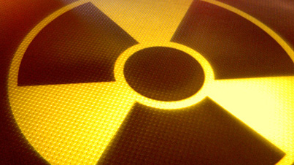
Radioprotection group

Slide 8
Radiations at CERN
in the accelerators, some protons escape the track of the magnetic field
atoms all around are hit and gain an excessive amount of energy
radiations are emitted to get rid of this energy

Slide 9
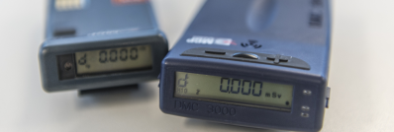
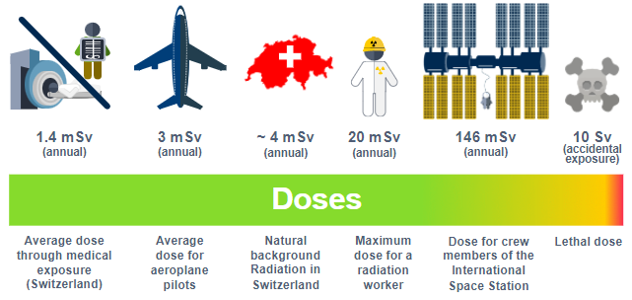
Radioprotection and dosimetry
Dose for an average CERN employee :
0,1 - 0,2 mSv/year

Slide 10
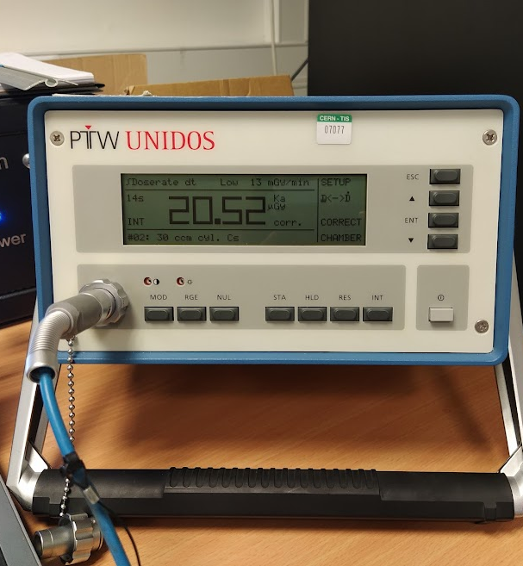
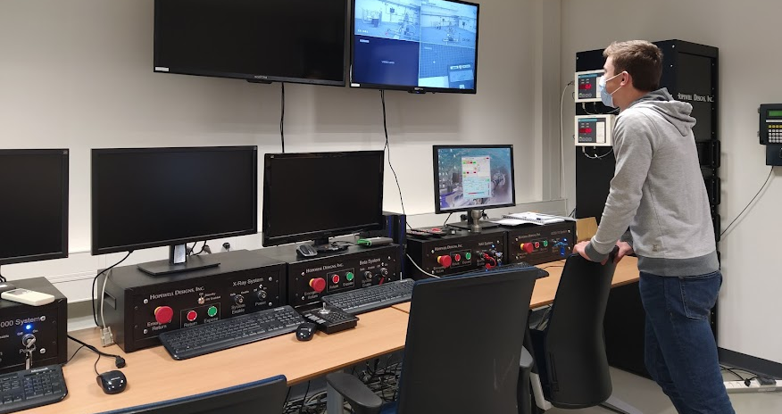
Our project

Slide 11
Results

Slide 12
Conclusion 2
Everyday we are exposed to natural radioactivity
The protons of the LHC or other accelerators produce some non-natural rays
However the radioprotection is there to make sure that nobody on the CERN site or around it gets exposed to a dangerous amount of radioactivity

Slide 13
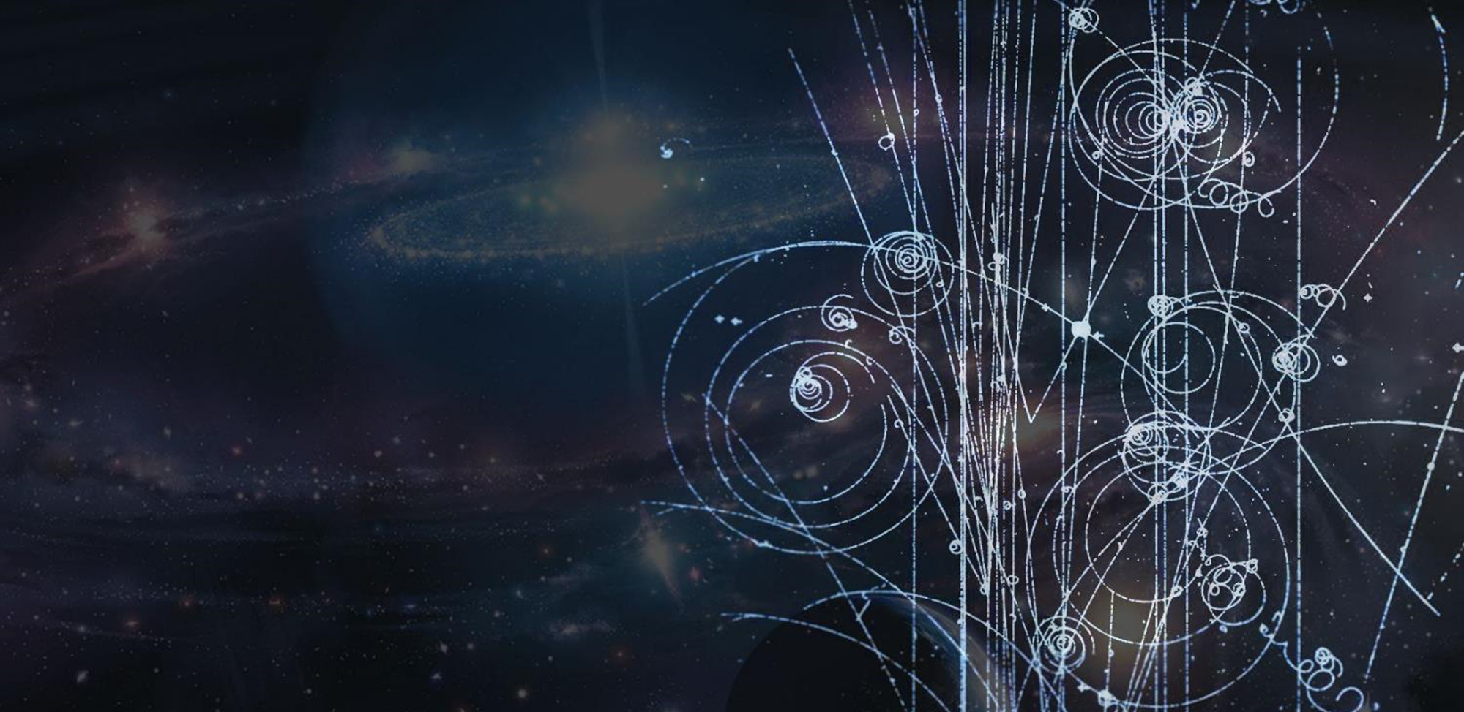
Post-HSSIP
What we did to share our experience

Slide 14
Presentation at my school
Explanation of what CERN is
Description of our project
Overview of the internship and what I learned from it
Funny anectodes

Slide 15
Newspaper : « Notre Collège »

Slide 16
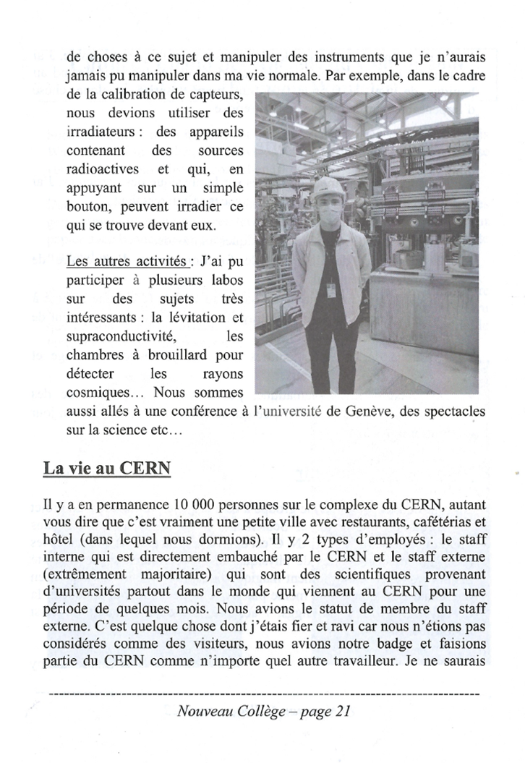
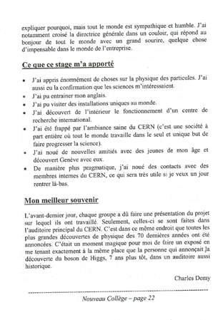

Slide 17
Presentation
What is CERN?
What was our project?
What is radioactivity?

Slide 18
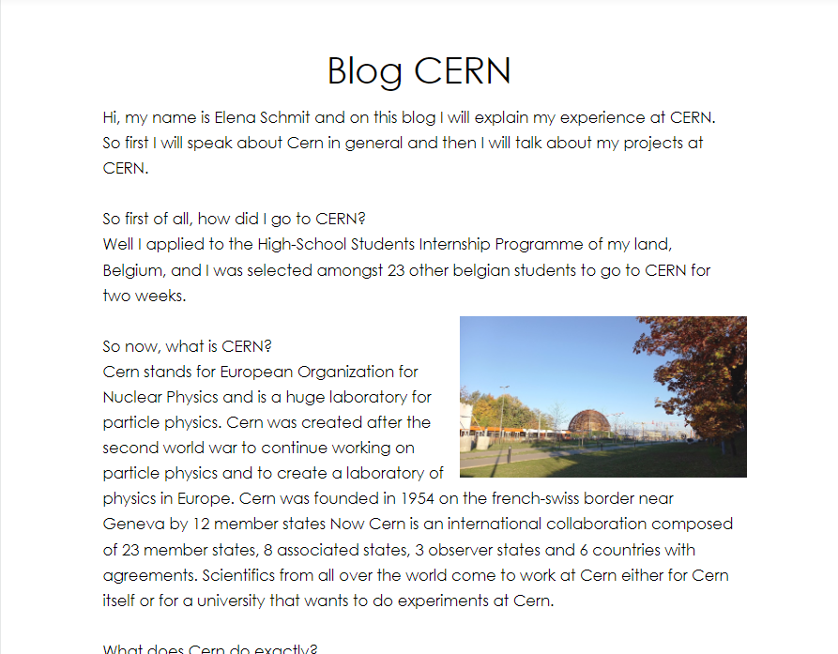
Instagram page + Blog

Slide 19
The benefits of the HSSIP
Descovering an international research center from the inside
Visiting incredible infrastructures
Pride
Meeting students from the same age that have the same interests
Learning new things

