Slide 1
Enhancing CERN's Educational resources database to test, evaluate and design science workshops

Slide 2
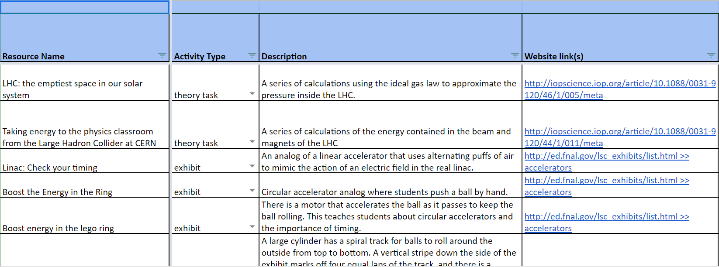
Database

Slide 3
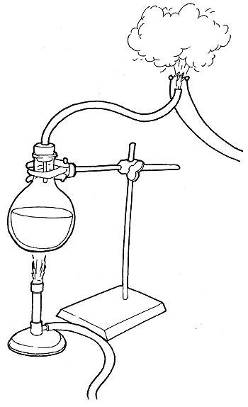
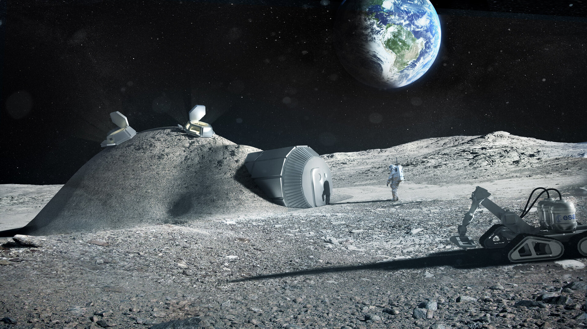
Evaluate Moon shelter & Jet of steam from boiling flask

Slide 4
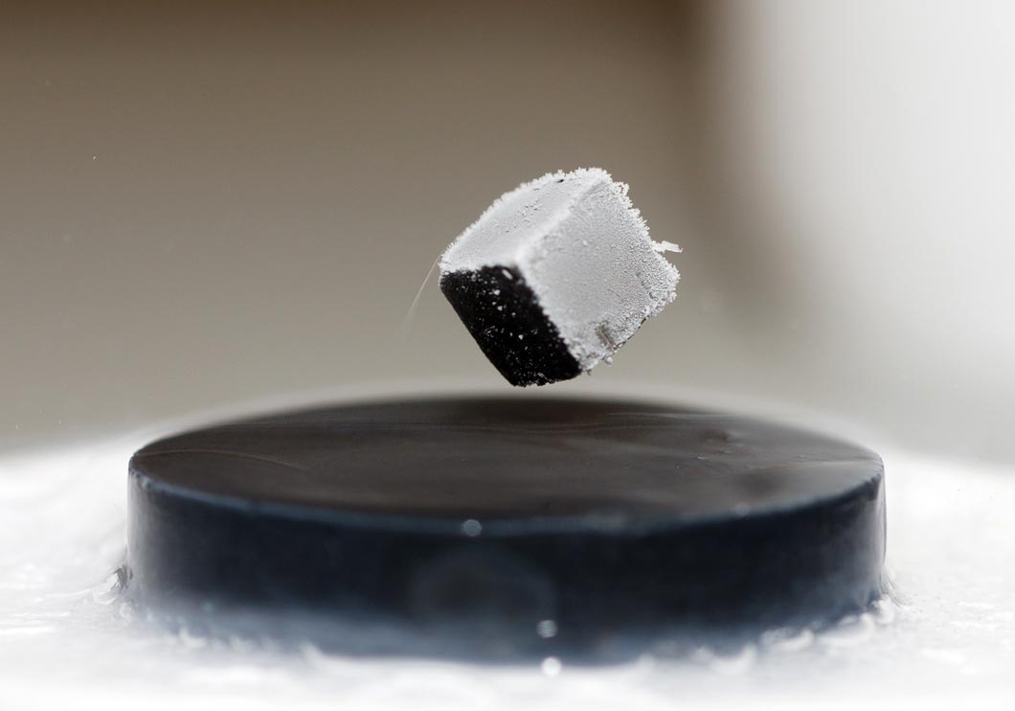
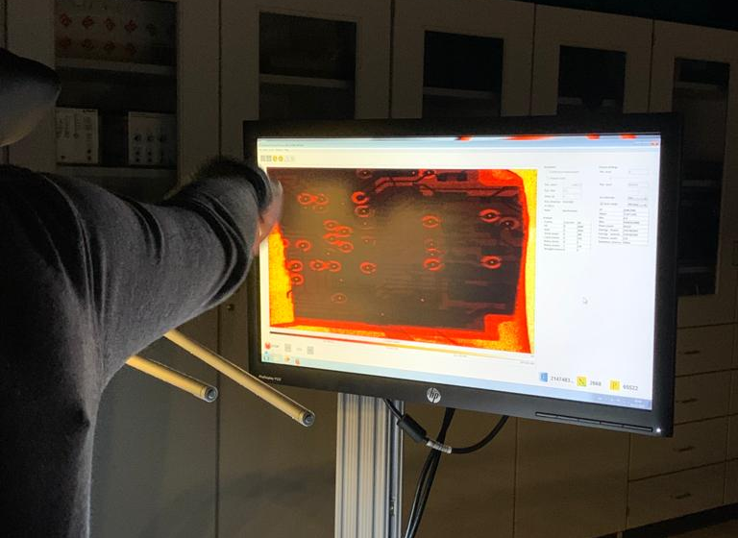
Test Different experiments

Slide 5
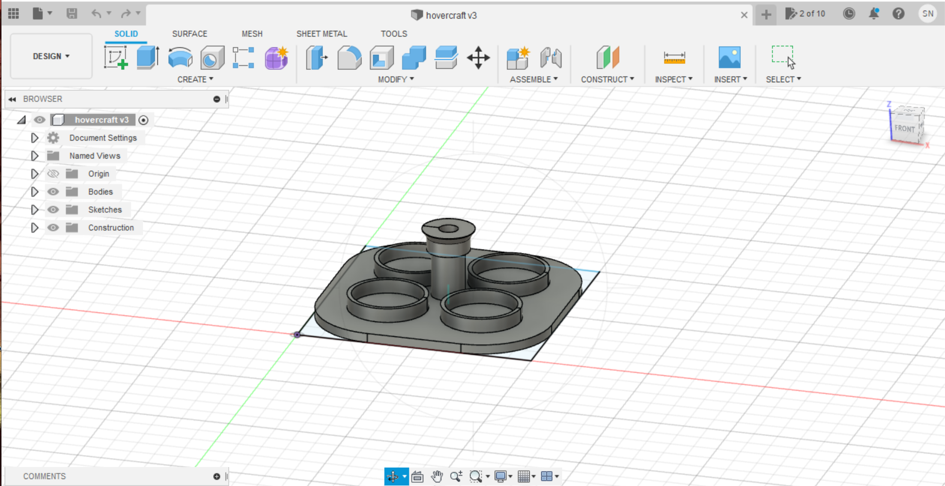
Design 3D printed Hovercraft

