Slide 1
CERN

Slide 2
Audiovisual production team

Slide 3
First week

Slide 4
Interview
24/10/2021-29/10/2021
Video editing editing
1
2
Photo editing
3
4
Sharing experience

Slide 5
Second week
01/11/2021-05/11/2021

Slide 6
Article
HSSIP video

Slide 7
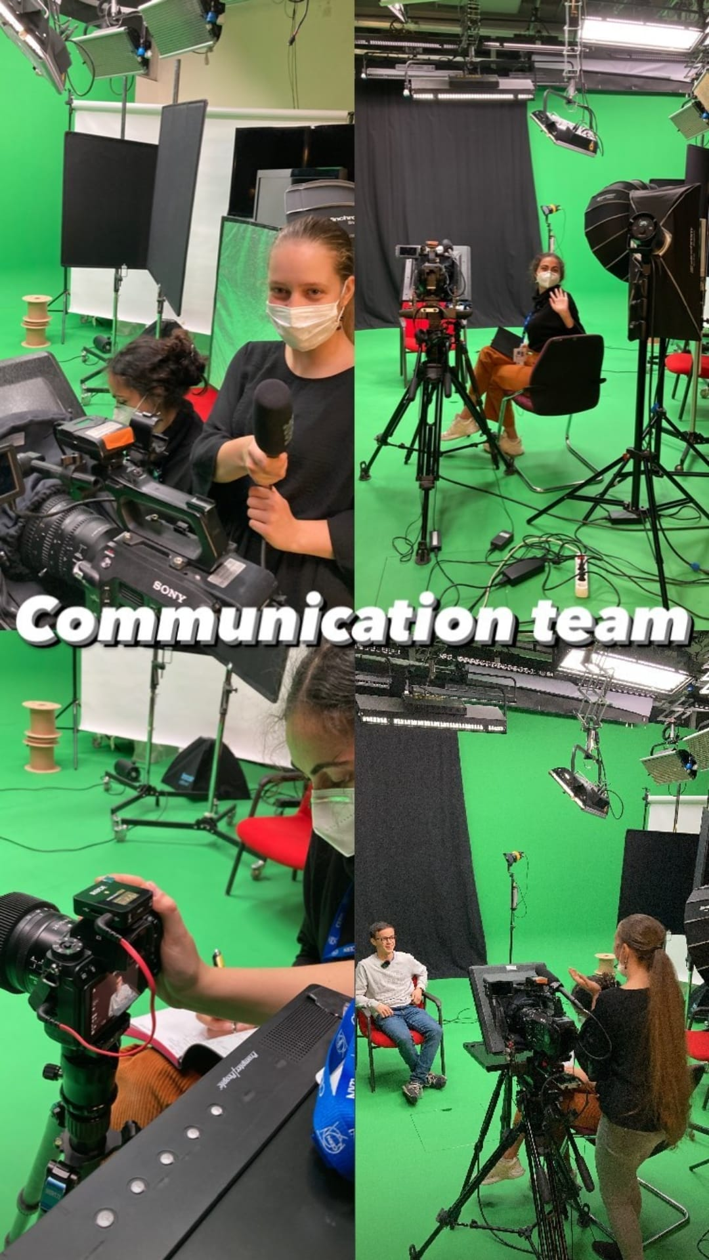

Slide 8
ABPPC
The Belgian Association of Physics and Chemistry Teachers

Slide 9
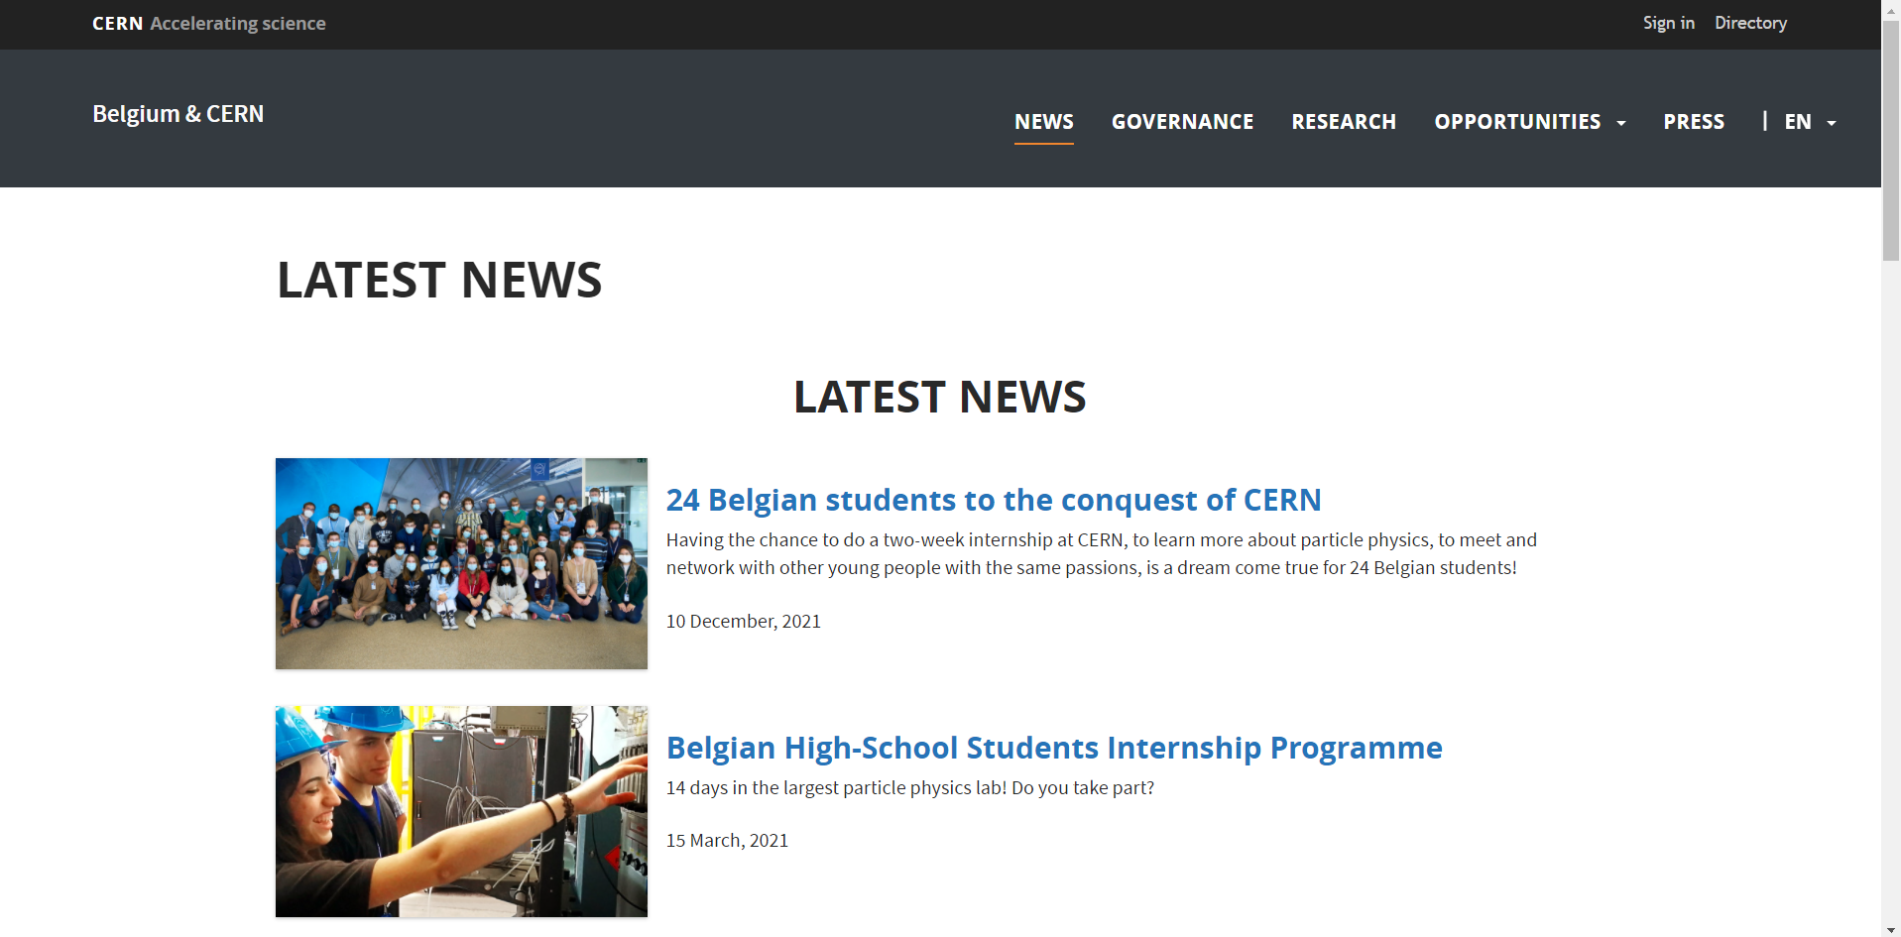
Website Belgium.cern

Slide 10
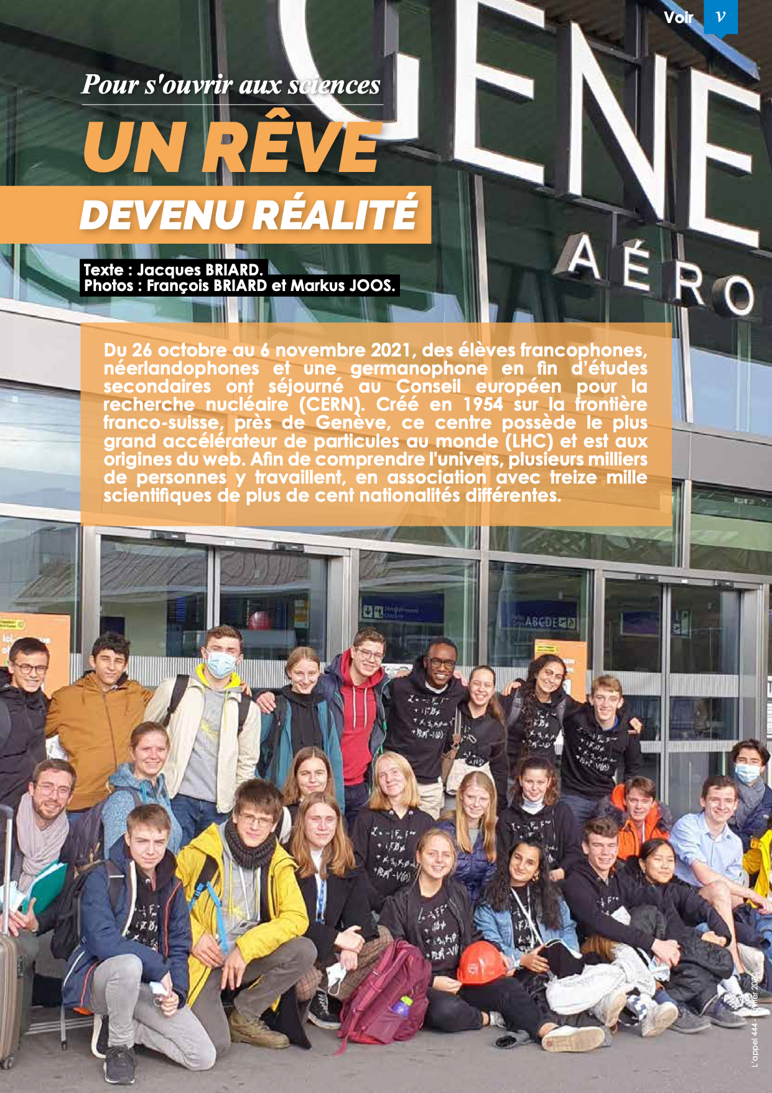

Slide 11
Thank you !

