Slide 1
Welcome
2021 Belgian HSSIP
Post-Internship Event
UNamur 26 March 2022
Welcome

Slide 2
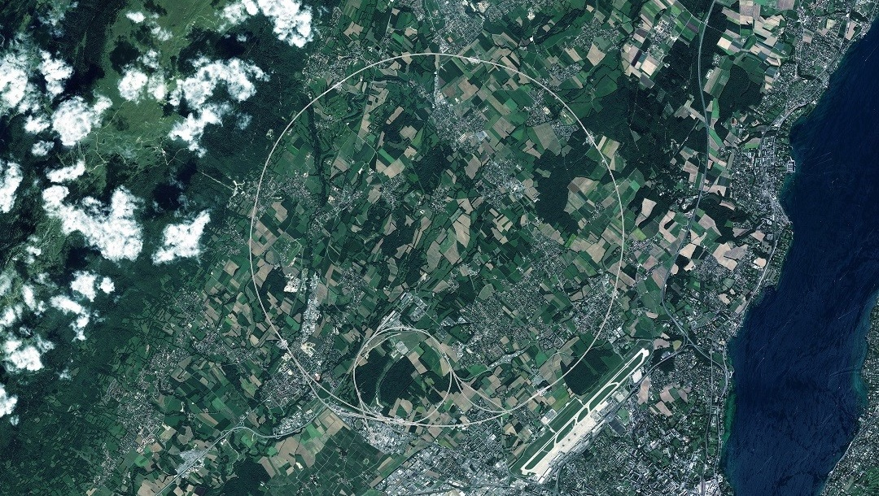
CERN

Slide 3
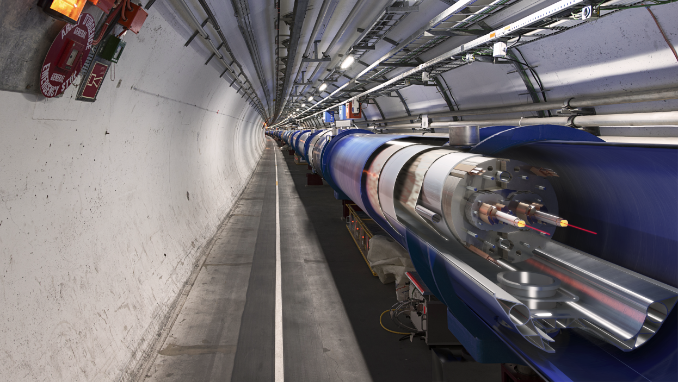
Accelerators

Slide 4
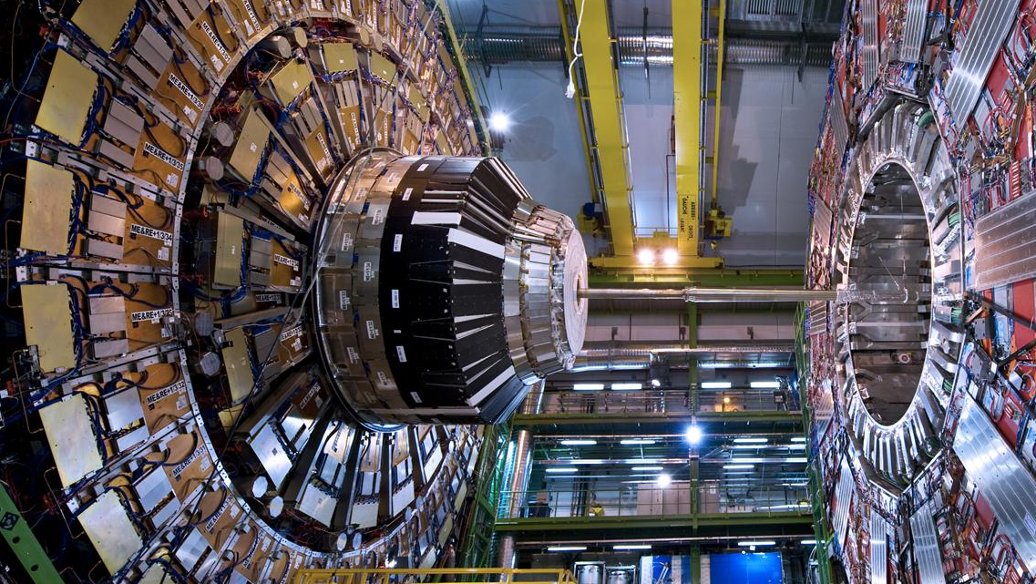
Detectors

Slide 5
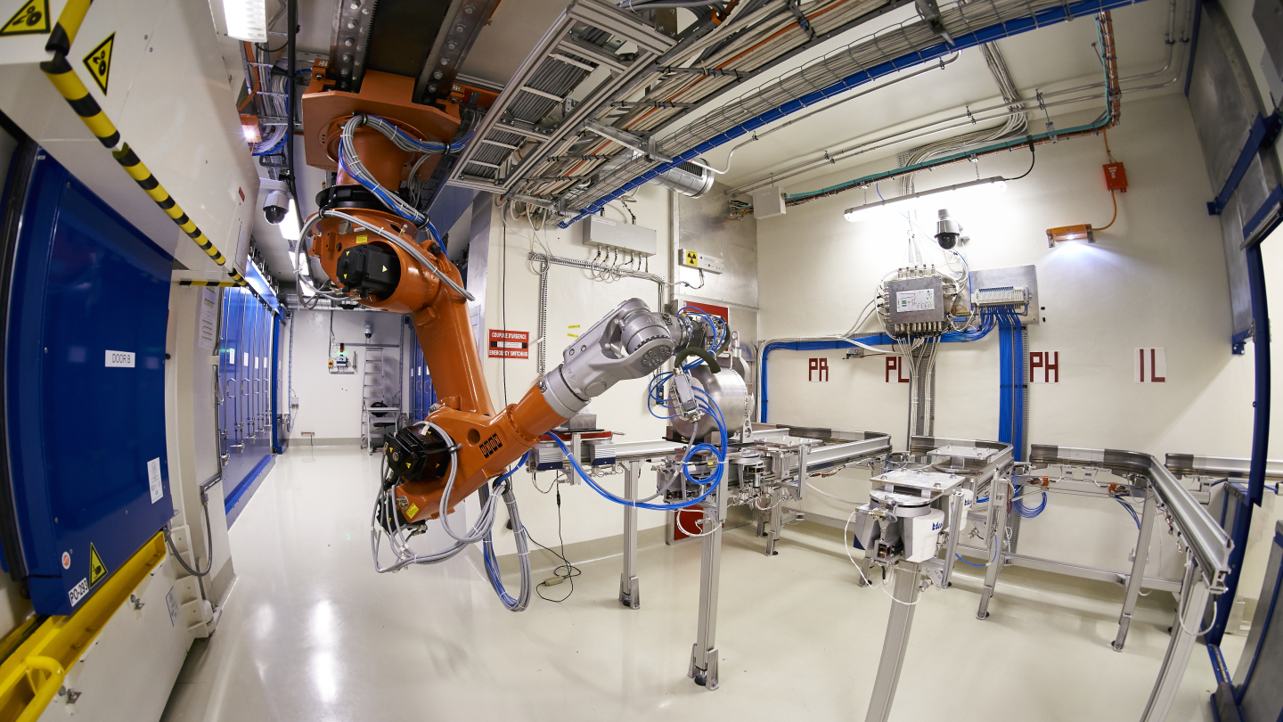
Technology

Slide 6
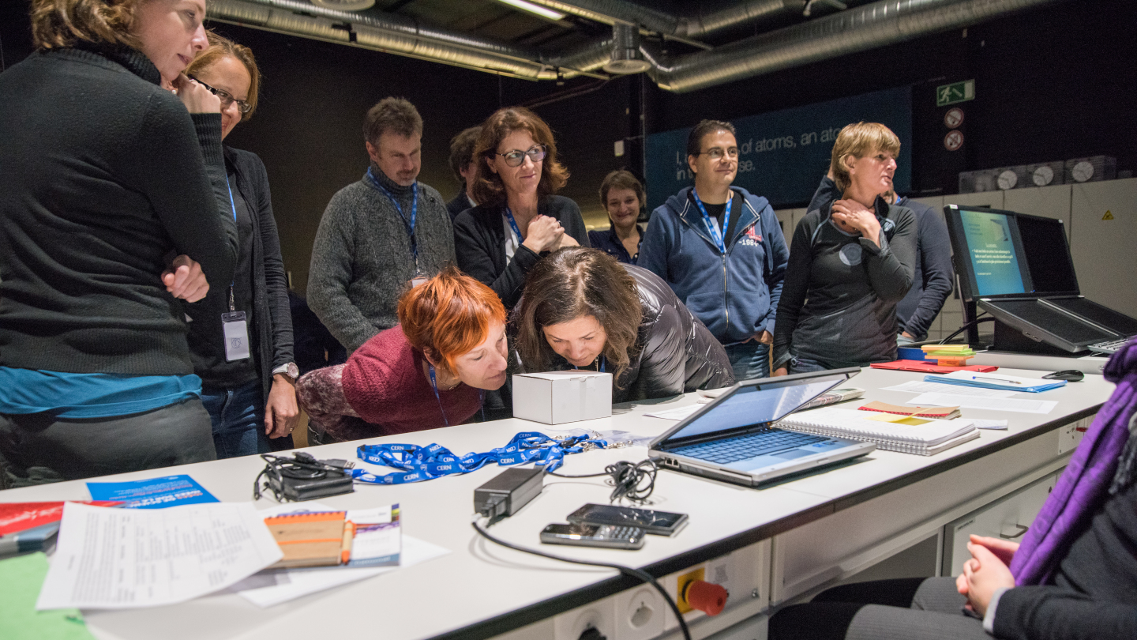
Education
Teachers
International teacher programmes
National teacher programmes
Students
High-School Students Internship Programme (HSSIP)
Beamline for schools
S’Cool LAB
Dans la peau de scientifiques

Slide 7
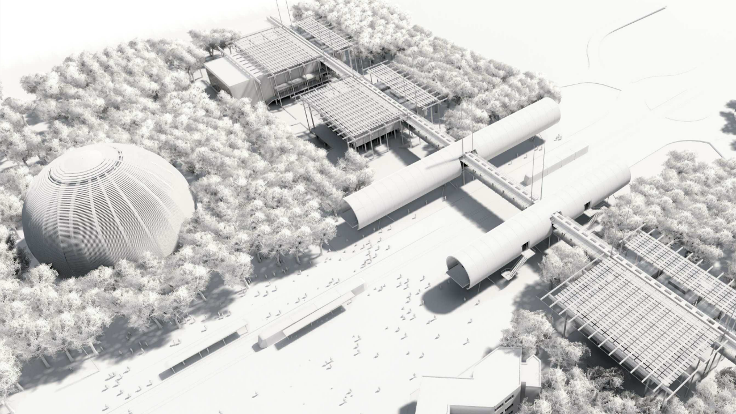
General public
Guided Tours
Exhibitions
Science shows
Hands on labs
Public events

Slide 8
HSSIP in a nutshell
Part of CERN’s teachers and students programmes offered by CERN Education, Communication and Outreach group
Goals
Hands-on opportunity in an international research laboratory
Instilling scientific curiosity
Motivating high-school students to take on a career in science, engineering, or another subject related to fundamental research
Format
5 Member States per year
Up to 24 high-school students (16 years+)
Two weeks internship at CERN
Two accompanying teachers
One national coordinator at CERN
Two national coordinators in the country
12 projects to be assigned to pairs of students
12 supervisors (possibly in sutdent’s mother tongue)

Slide 9























All HSSIP programmes so far
2017 | 2018 | 2019 | 2020 | 2021 | 2022
Bulgaria | Czech republic | Austria |  | Greece | Italy
France | Israel | Finland |  | Denmark | Serbia
Hungary | Netherlands | Germany |  | Switzerland
Norway | Poland | Slovakia |  | Belgium
Portugal | Sweden | Spain |  | Romania

Slide 10
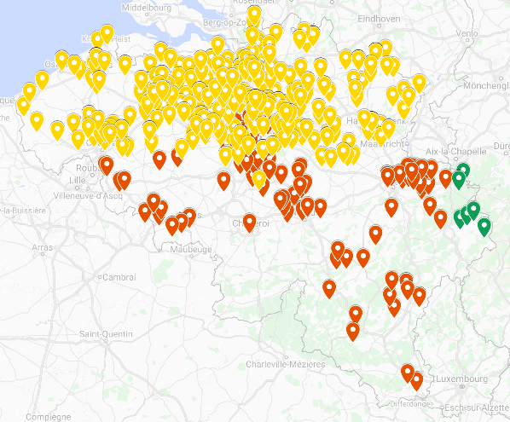
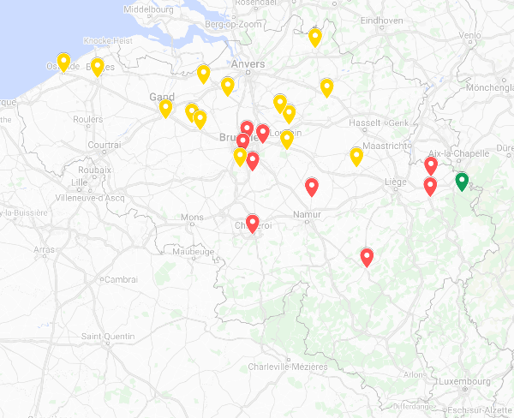





BE-HSSIP selection
583 applications
(a record number in comparison to population size)
24 selected students, following predefined quotas

Slide 11
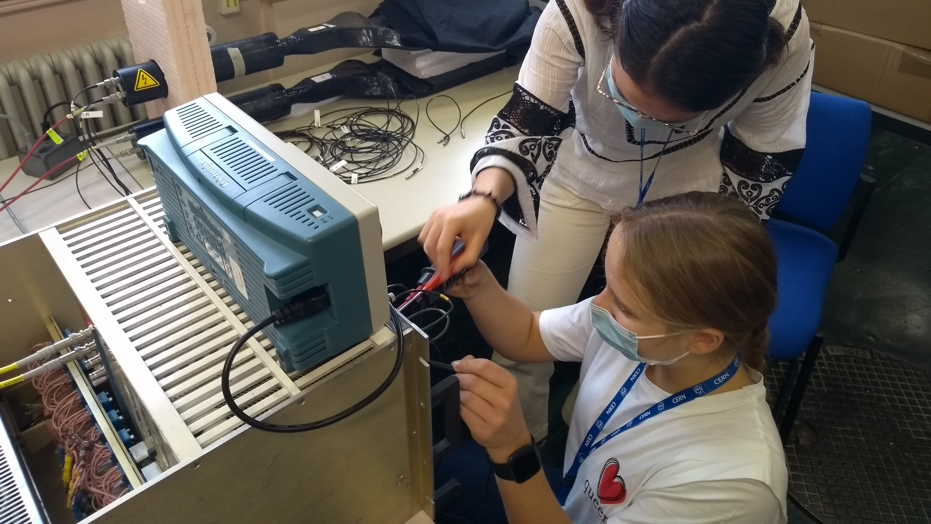
BE-HSSIP Projects
Accelerators
Accelerator control
Artificial intelligence in accelerators
Safety
Radioprotection and
environment monitoring
Experimental physics
ISOLDE CRIS Team: DAQ development
ISOLDE WISArD Team: alpha-/beta decay
CMS Data Analysis
Detector technology
Muon detection
Information Technology
Anayzing massive datasets in the cloud
Internet of Things and data visualization in augmented reality
Education and communication
Enhancing CERN's Educational Resources Database
to test, evaluate and design workshops
Science communication

Slide 12
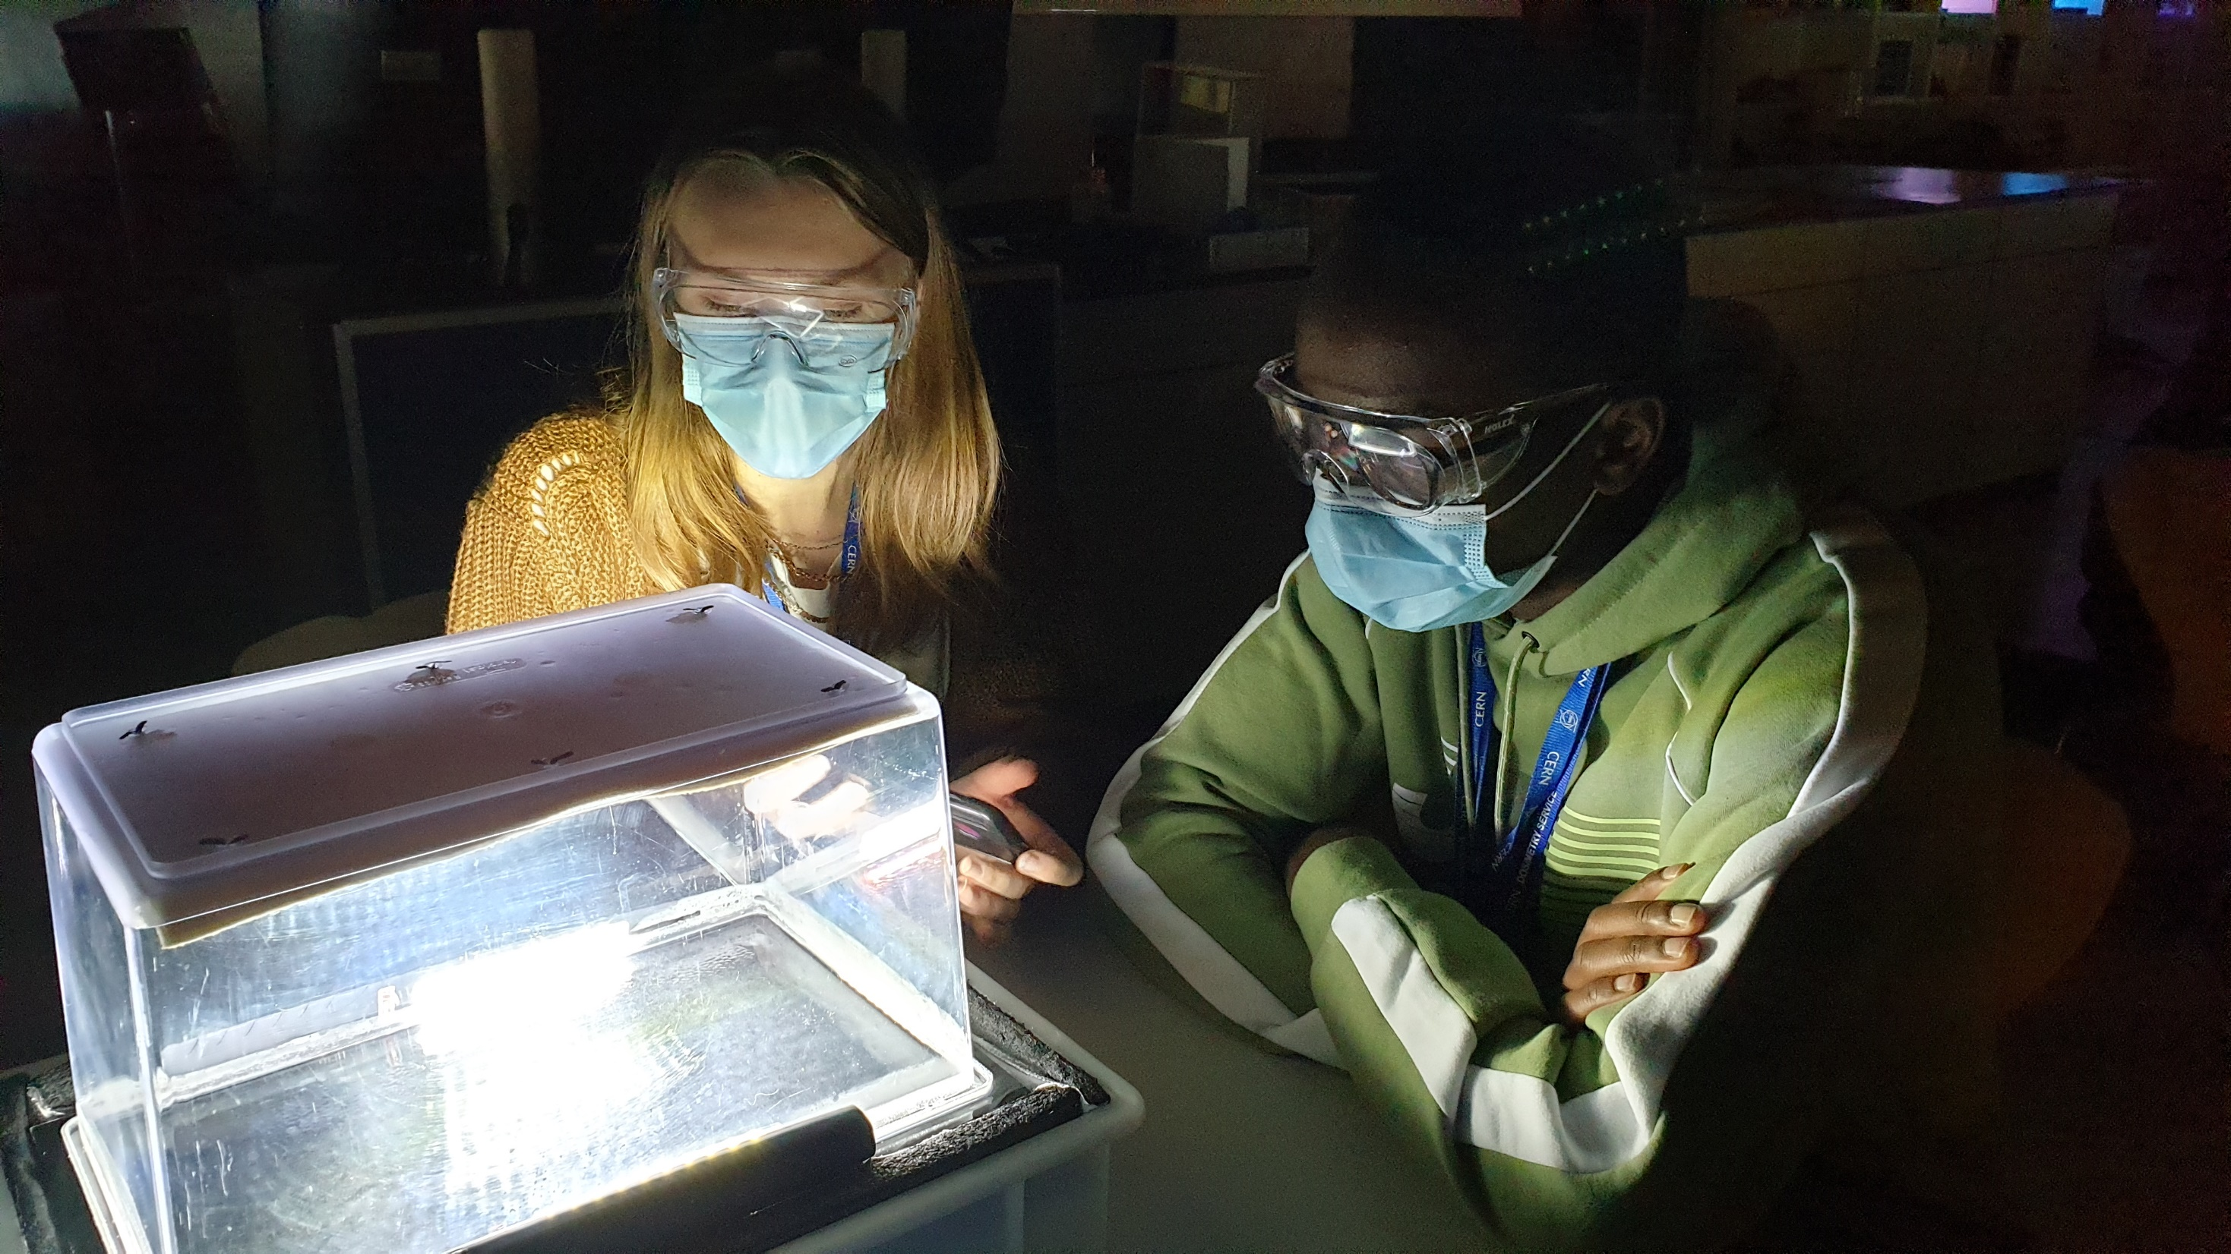
Workshops

Slide 13
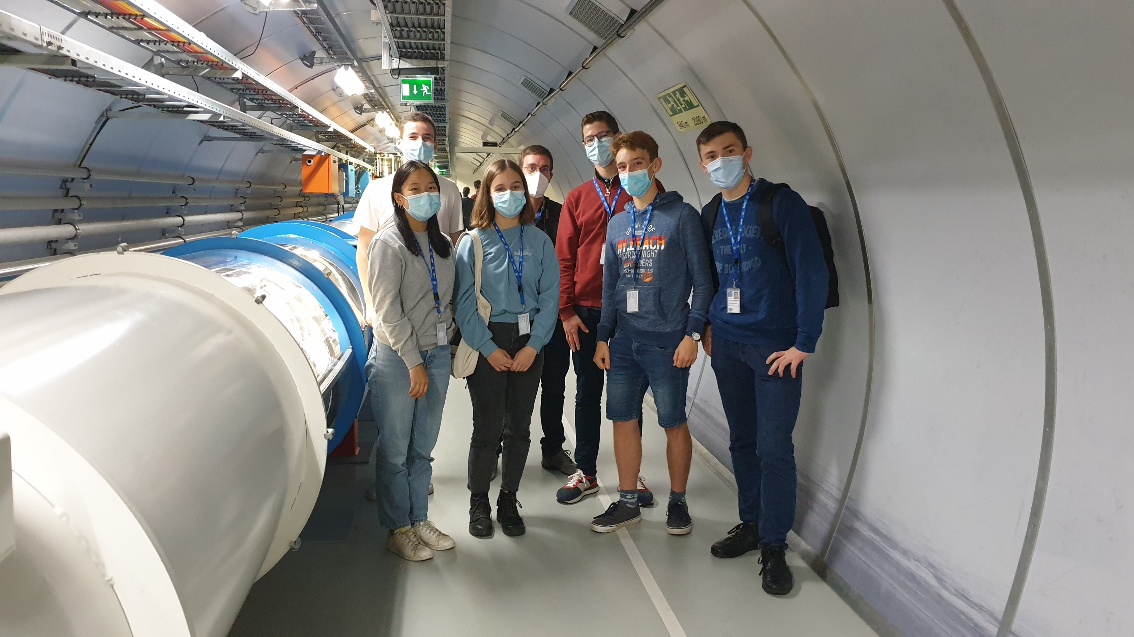
Guided tours

Slide 14
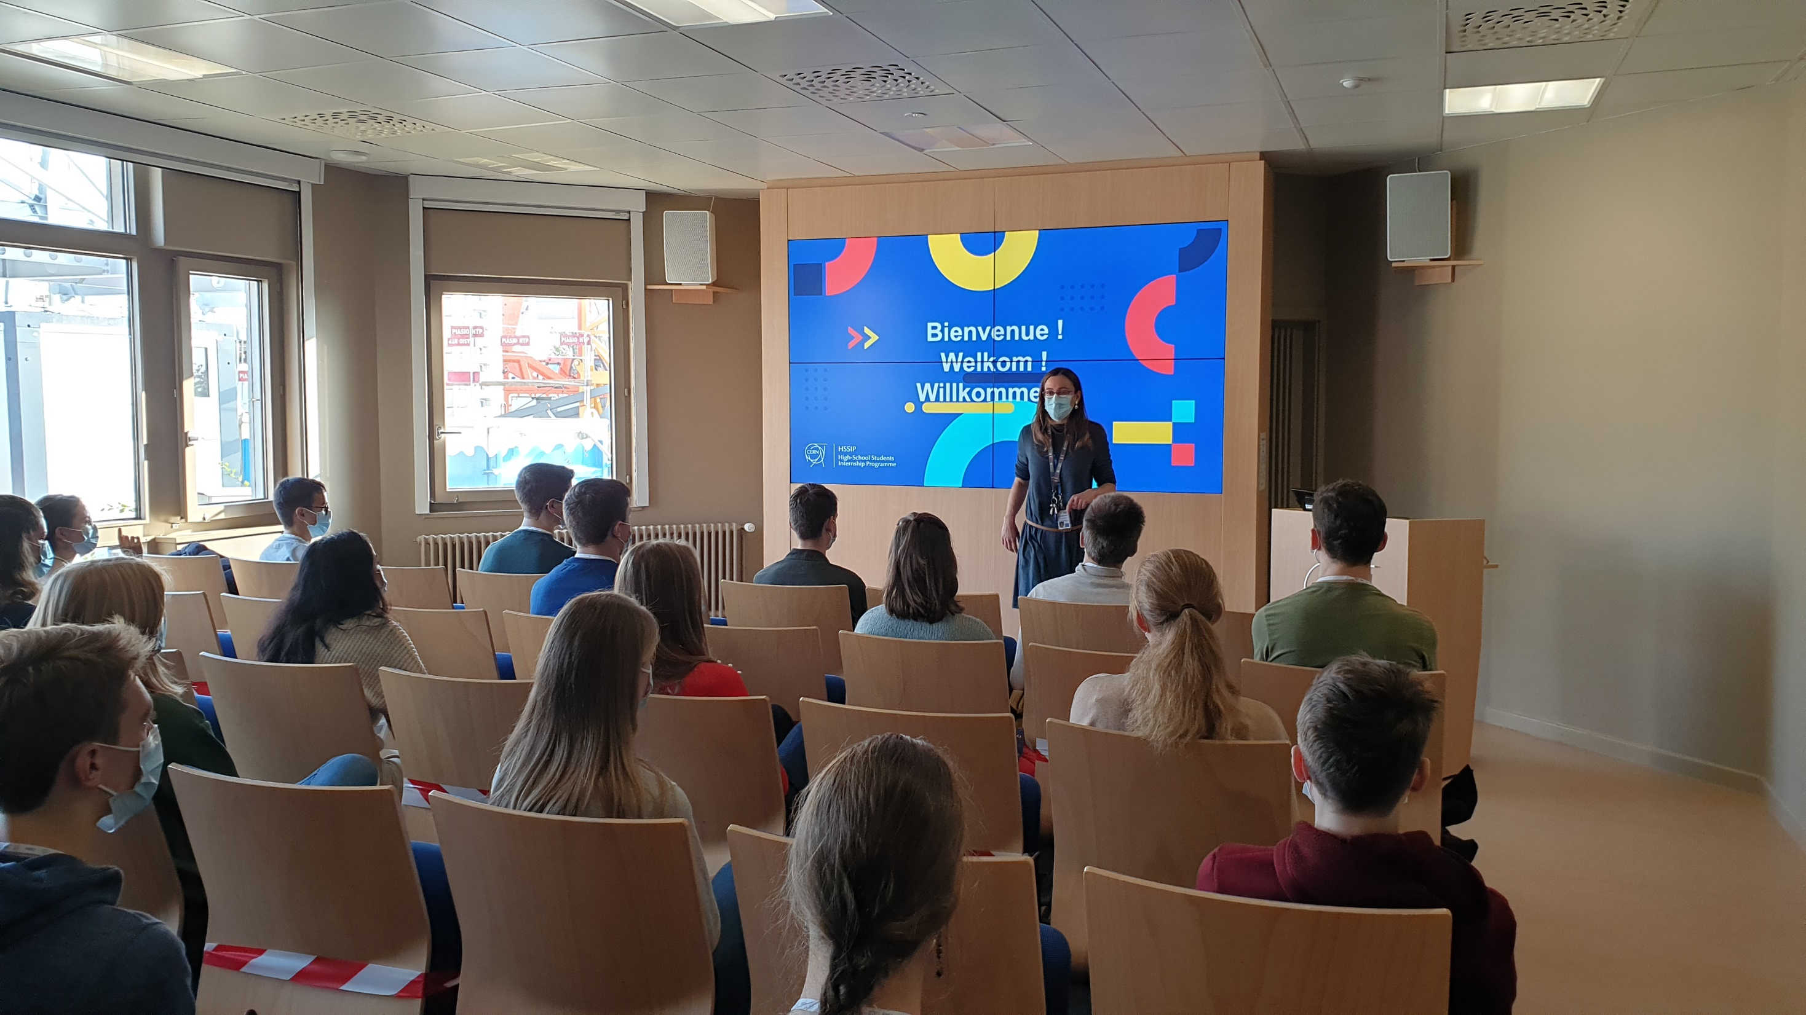
Lectures

Slide 15

Events

Slide 16
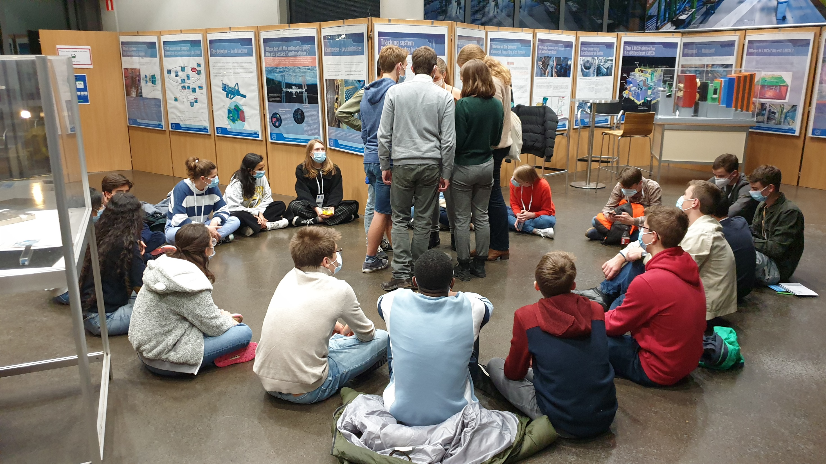
Life on campus

Slide 17
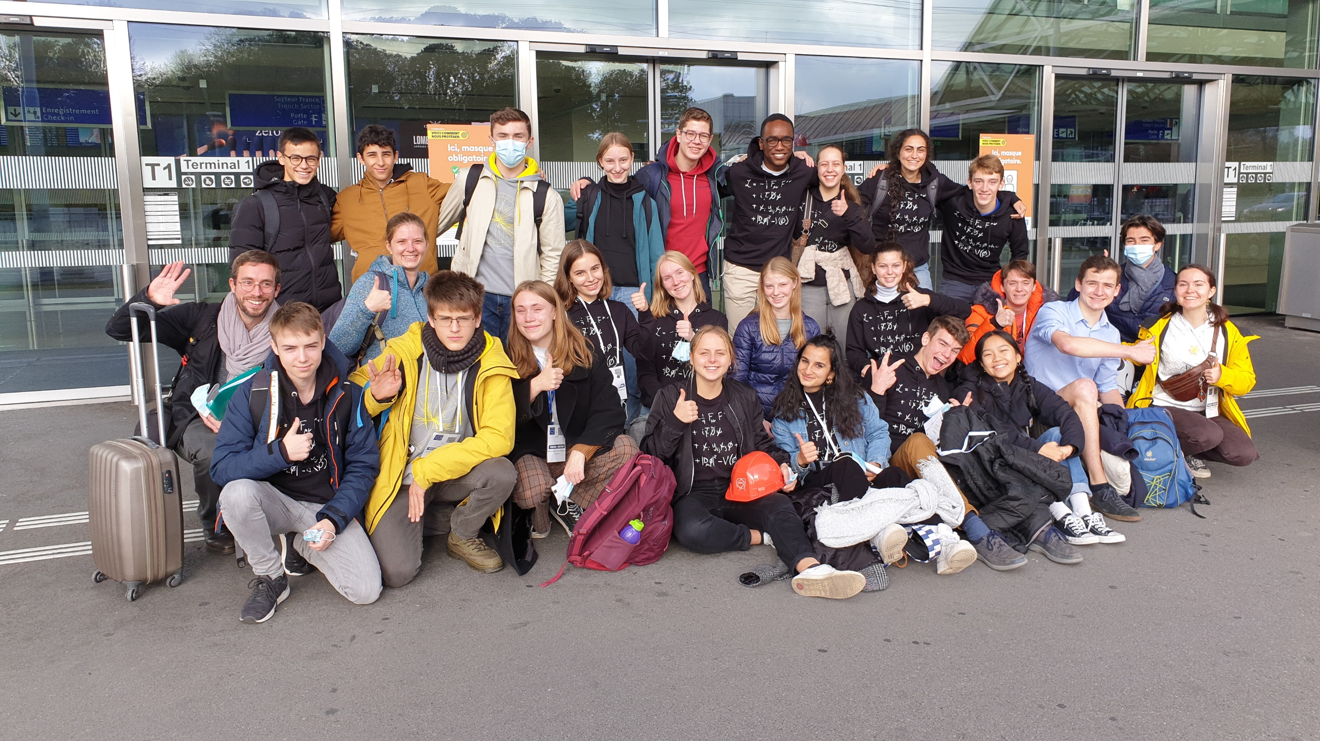
Thank you Bedankt Merci Danke

