Slide 2
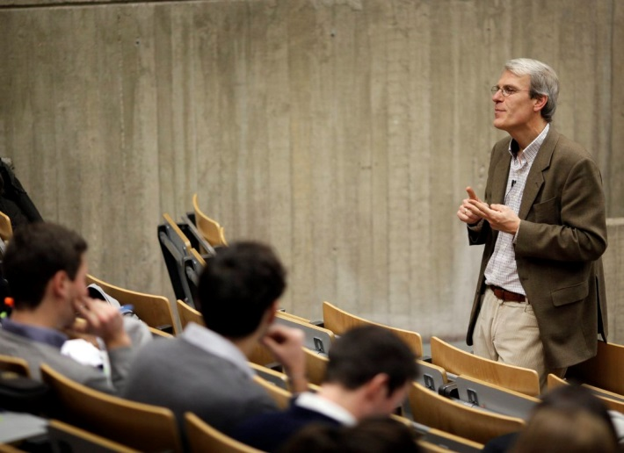
A University of 8394 persons
7158
Students
330 Academics*
513 Researchers*
464
administrative and technical staff*
*Total staff EFT: 927

Slide 3
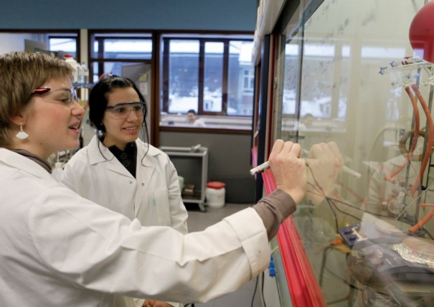
Research in figures (2020)
785 researchers (academics + researchers)
386 PhD students
32% international
250 contracts
1021 publications
11 research institutes
51 research units
9 technology platforms
R&D projects
24 millions euros

Slide 4
Interdisciplinarity : 11 research institutes

Slide 5
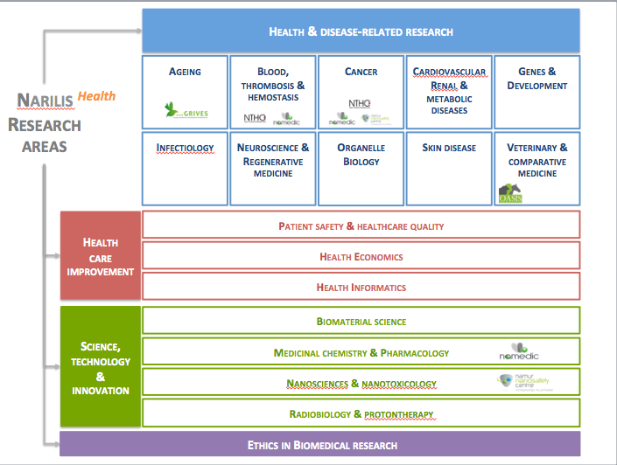
Institutes
NaXys
Complex systems
Life
sciences
NARILIS
NADI
Digital & computer sciences
Material/surface
physico-chemistry
NISM
ESPHIN
Ethics & philosophy
Environment
ILEE
11 interdisciplinary INSTITUTES
DeFiPP
Development, finance
& public politics
Didactics
IRDENa
Transitions
PaTH
Vulnerability,
ageing
& security
NALTT
Traces, Transmissions & Heritage
Language, Text & Transmediality

Slide 6
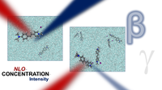
Research poles
Non-Linear Optics and Photonics
High Performance Computing (HPC) Multiscale Modelling
Functional Structured Materials
Surfaces, Interfaces and Carbon Nanostructures

Slide 7
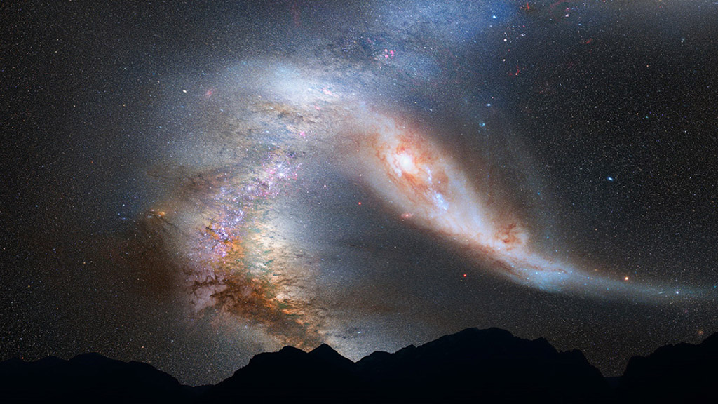
Dynamical astronomy, cosmology and astrobiology (SPACE)
This research pole deals with the modelling of the Universe, on different scales: space debris, Solar System, extrasolar systems, up to the large-scale structures of the Universe. We will focus on the non-linear interactions and chaotic dynamics of these physical and mathematical objects, sharing the tools of celestial mechanics, cosmology, general relativity and modified gravity.
Keywords: Celestial Mechanics, Extrasolar
Planets, Cosmology, Numerical Relativity,
Astronomy
Contacts: André Fuzfa and Anne-Sophie Libert

Slide 8
Technology platforms
Level 3 Biosafety Lab
Materials synthesis, irradiation & analysis
BL3
Genetics & genomics
SIAM
GENOMICS
Big data, super-computing
Lasers, optics & spectroscopy
PTCI
LOS
8 technology platforms
Animal facility
PTSV
Proteomics & mass spectrometry
MaSUN
PC²
Morph-Im
Chemical characterization
Morphology & imaging

Slide 9
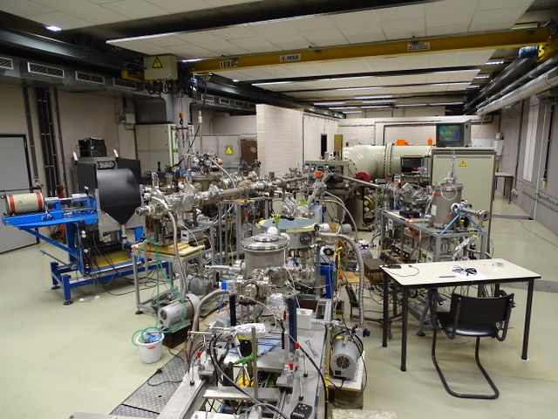
Particle accelerator
proton irradiation + comparison with X ray irradiation
Ion implantation
Materials analysis by ion/matter interaction analysis

Slide 10
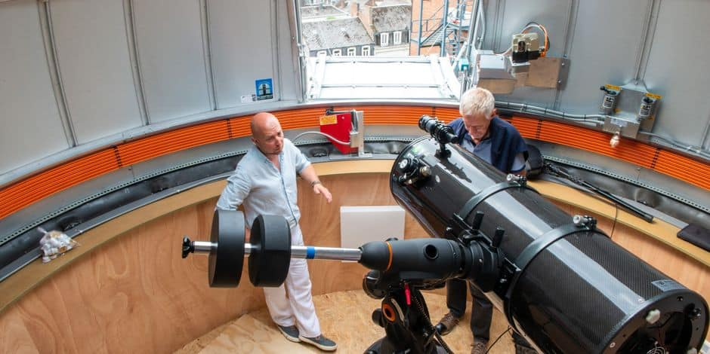
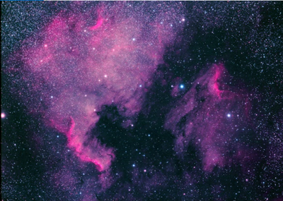
Namur astronomy observatory

